Slide 1
System dynamics for system innovation
Parameterising the POLYTROPOS model
Hedvig Norlén, UrbanStat Italy
joint work with: George Papachristos (JRC B7), Matthijs Janssen (U. Utrecht), Michal Miedzinski (JRC B3), George Papachristos (JRC B7), Dimitrios PONTIKAKIS (JRC B7)
3rd Working Group on System Dynamics for System Innovation,
Brussels 12/11/2024

Slide 2
NZIA perimeter – mapped economic act. (NACE)
Net-Zero Industry Act* (NZIA) encompasses final products, components, and machinery necessary for manufacturing net-zero technologies, including:
* Regulation (EU) 2024/1735 of the European Parliament and of the Council of 13 June 2024 on establishing a framework of measures for strengthening Europe’s net-zero technology manufacturing ecosystem

Slide 3
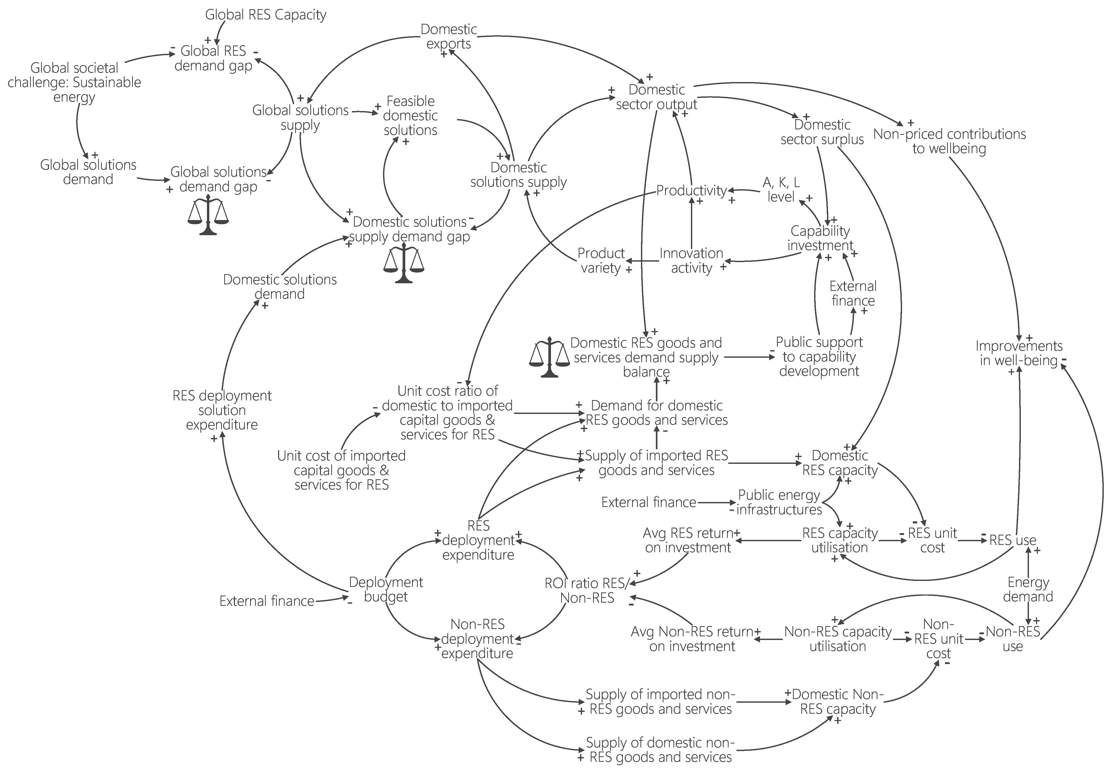
Source: Eurostat, SBS/Figaro I-O tables
Special mention to Luis Enrique Pedauga (B7) and Jose Manuel Rueda Cantuche (B7)
Perimeter: NZIA product-sectors
Treatment: Query, Regressions for parameters
Variables: knowledge stocks (A), capital stocks (K), and labour (L) - affect the output level (Y)

Slide 4
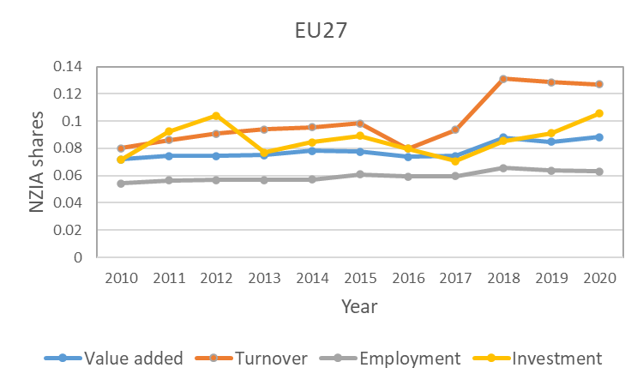
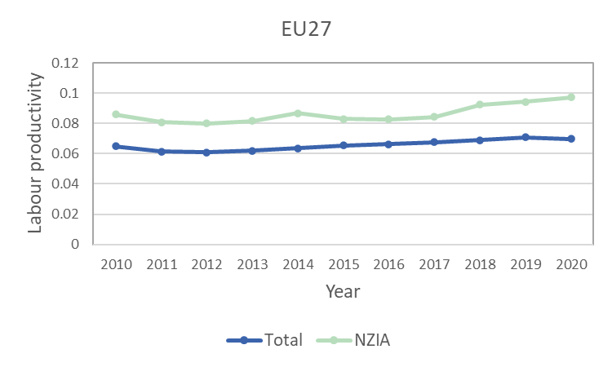
A, K , L level
The coefficients/output elasticities for the production function are estimated using panel regression models testing for fixed/random/mixed effects. Panel period 2010-2020

Slide 5
A, K , L marginal effects on Y – regression estimates
The regressions provide estimates of how changes in each of these input factors—typically knowledge stocks (A), capital stocks (K), and labour (L) —affect the output level (Y).
We have only done the regressions for the general economy, not for the RES/NZIA nexus yet (we plan to do this soon).
The regression estimates for each coefficient vary in different specifications of the regression, depending on the proxies used for Y (value added, turnover), K, L and A.
This variance gives us a range within which the coefficients are allowed to vary in the model.

Slide 6
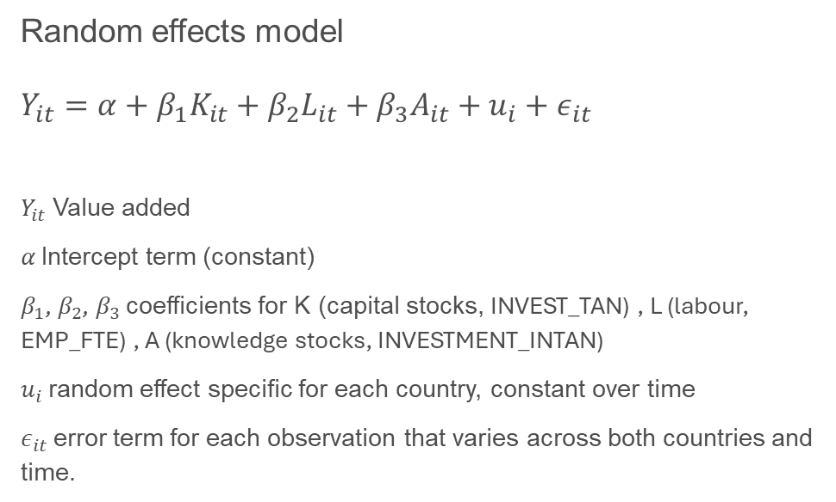
A, K , L marginal effects on Y – regression estimates
Random effects model
$$Y_{it}=α+β_{1}K_{it}+β_{2}L_{it}+β_{3}A_{it}+u_{i}+ε_{it}$$
$Y_{it}$ Value added
$α$ Intercept term (constant)
$β_{1}$, $β_{2}$, $β_{3}$ coefficients for K (capital stocks, INVEST_TAN) , L (labour, EMP_FTE) , A (knowledge stocks, INVESTMENT_INTAN)
$u_{i}$ random effect specific for each country, constant over time
$ε_{it}$ error term for each observation that varies across both countries and time.
$$Y_{it}=−799.80+0.97K_{it}+0.04L_{it}+1.28A_{it}+u_{i}+ε_{it}$$

Slide 7
Variables: GSD, GSS
Source: Eurostat, Figaro I-O tables
Special mention to Luis Enrique Pedauga (B7) and Jose Manuel Rueda Cantuche (B7)
Perimeter: NZIA product-sectors
Variables: DSD, DSS, DSD, gap

Slide 8
Domestic Solutions Supply
FIGARO Supply tables (time period: 2010-2022). For EU27 (for all EU MS matrices) calculate:
Two ways of product diversification for DSS:
1) ”Equally sized products” → 1/HHI
HHI = Herfindahl-Hirschman Index (calculated as sum of squares of shares of the 64 products across the NZIA perimeter for each MS)
2) ) ”Product variety” → the variety of product-sectors a country was actively producing in.
This variety indicator took a value of 1 for every product-sector that was active. We also tried a variant with a minimum of 10m EUR.
Notes:
Speaking point: HHI is an indicator commonly used in economics to measure concentration (or variety and balance). Its reciprocal (1/HII) has an intuitive interpretation: equivalent to the number of equally sized sectors that would produce the same concentration index value.
”Product variety” → the variety of product-sectors a country was actively producing in. This variety indicator took a value of 1 for every product-sector that was active. We also tried a variant with a minimum of 10m EUR.

Slide 9
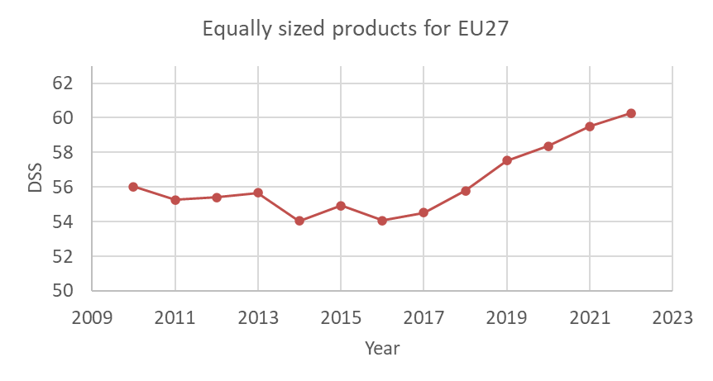
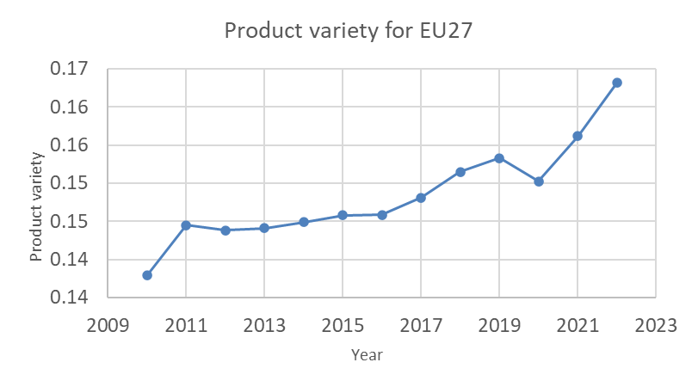
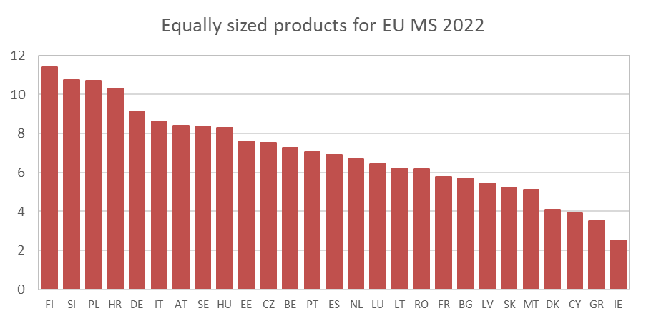
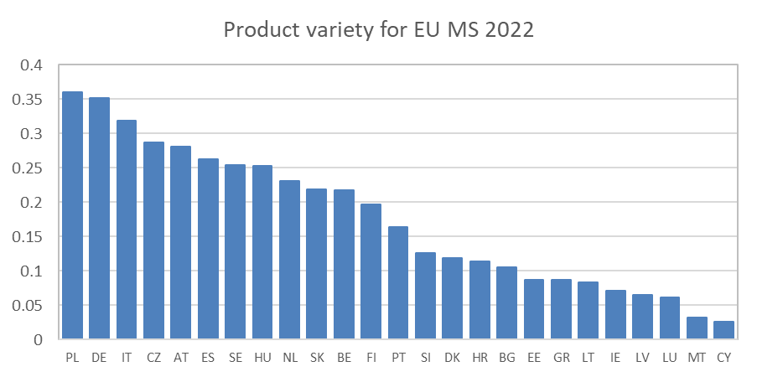
Domestic Solutions Supply
Note: Values for RO and FR are missing/uncertain.

Slide 10
Domestic Solutions Demand
FIGARO Use tables (time period: 2010-2022). The Use tables contain intermediate but also final use (five categories for each EU MS).
Also here two ways of product diversification for DSD:
1) ”Equally sized products” → 1/HHI
2) ”Product variety” → the variety of product-sectors a country was actively producing in (to be calculated).
Notes:
Intermediate use refers to the consumption of goods and services by industries as inputs in their production processes. These are not final goods but are used to produce other goods and services.
Final use represents the consumption of goods and services that are not used for further production but rather meet end-user demand. (government and household consumption, gross fixed capital formation).

Slide 11
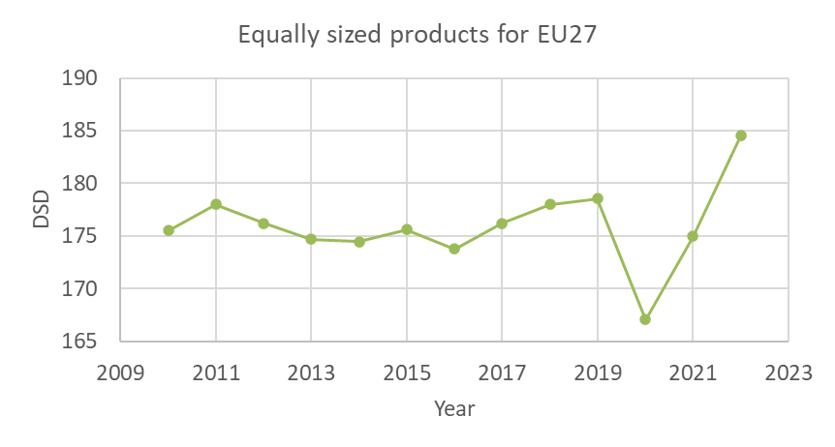
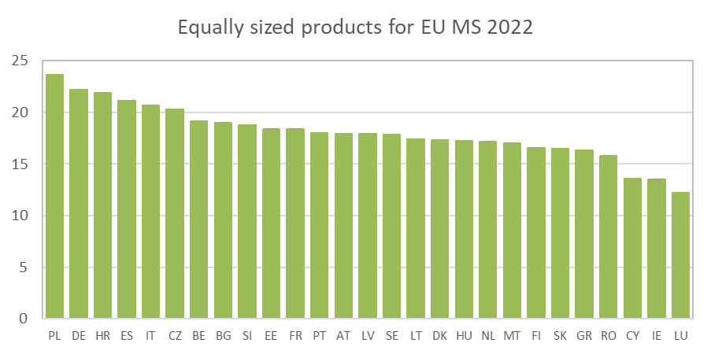
Domestic Solutions Demand

Slide 12
Domestic Solutions Demand Gap
FIGARO Use tables (time period: 2010-2022)
The Gap comprises two components:
1) the Domestic Demand served by Domestic production (DDD)
2) the Domestic Demand served by Imports (DDI)
Relative Gap DDI/DDD, Absolute DDD-DDI, Dependency Ratio = DDI/(DDI+DDD)
Notes:
46 countries in the FIGARO tables. Dependency Ratio = DDI/(DDI+DDD). This ratio ranges from 0 to 1 and indicates the share of a country’s domestic demand that come from imports. It shows the degree of dependency on external sources as a fraction of total input.

Slide 13
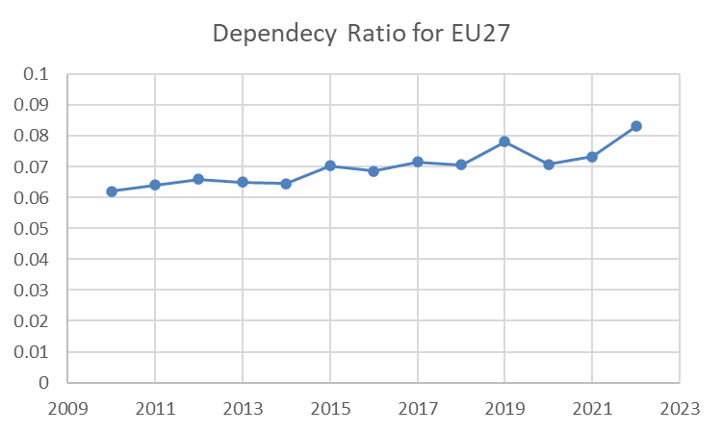
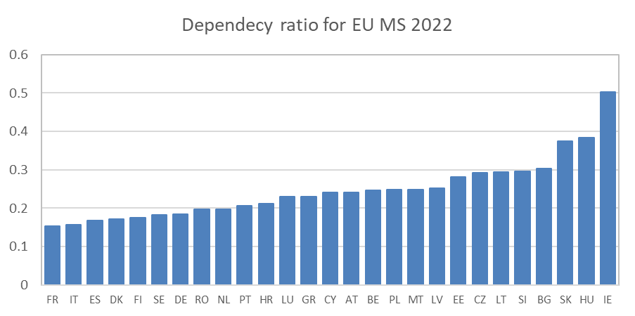
Domestic Solutions Demand Gap
Notes:
46 countries in the FIGARO tables
Dependency Ratio = DDI/(DDI+DDD). This ratio ranges from 0 to 1 and indicates the share of a country’s domestic demand that come from imports. It shows the degree of dependency on external sources as a fraction of total input.

Slide 14
Global Solutions Supply and Demand
The complete FIGARO datatables (27 EU MS, 18 main EU trading partners, a rest of the world region). Calculated as for EU27 (time period: 2010-2022)
Questions
How might we introduce complexity as a measurable parameter without overcomplicating the model? What trade-offs would you consider?
What approaches do you know of (e.g., entropy, network analysis, diversity indices) that could serve as proxies for complexity?
In the context of DSD, how could complexity in product variety influence the gap between domestic supply and import dependency? Could complexity metrics help us better understand supply-demand mismatches?

Slide 15

Thank you
hedvig.norlen@urbanstat.eu
© European Union 2023
Unless otherwise noted the reuse of this presentation is authorised under the CC BY 4.0 license. For any use or reproduction of elements that are not owned by the EU, permission may need to be sought directly from the respective right holders.

