Slide 1

Policy insights from an evolutionary model of technology transformations: The Future
Technology Transformations (FTT) Model
Brussels, November 2024
Femke Nijsse

Slide 2
FTT model basics
Developed in 2012 by Jean-Francois Mercure
Used in combination with E3ME to assess policy in EU and abroad
Coverage: 71 world regions, including all EU regions
Sectors: power, cars, trucks, steel, residential heating. Hydrogen in development
Goal: assess effectiveness of various policy mixes (fiscal & regulations)
Maintained by: Exeter, World Bank, CE

Slide 3
Core dynamics
Dynamics: Coupled logistic differential equations Similar to predator-prey equations | Investor choices (fitness) Based on perceived costs Modified by historical preferences from historical shares time series Industry strength: large industries add more capacity per year Inertia: each technology has a lifetime and lead time
Deployment
Learning-by-doing
Lower costs
More investment

Slide 4
Replicator dynamics
Market strength
A larger market means there is more money in the sector to invest
Social contagion
When your neighbours have solar panels and EVs, you’re more likely to adopt
Network effects
For technologies such as EVs, more cars implies a denser and higher-quality charging network.
The growth of a technology is proportional to current shares
This encapsulates 3 types of feedbacks.

Slide 5
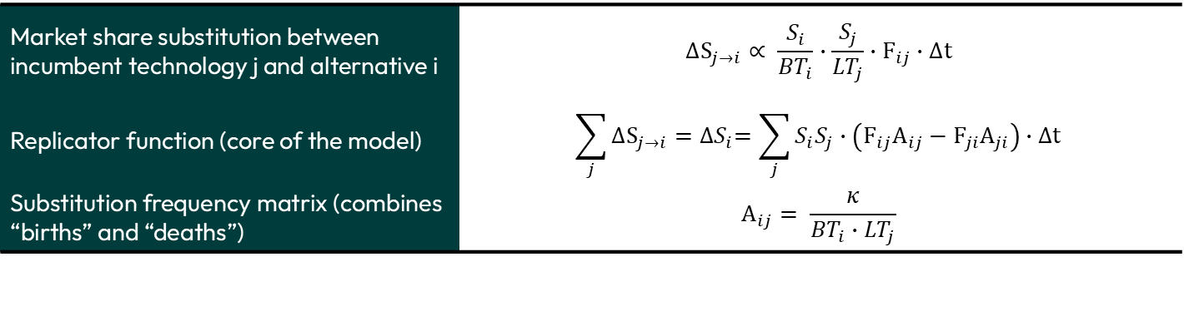
Mathematical framework – Market shares
Market share substitution between incumbent technology j and alternative i | $$∆S_{j→i}∝ \frac{S_{i}}{{BT}_{i}}∙\frac{S_{j}}{{LT}_{j}}∙F_{ij}∙∆t$$
Replicator function (core of the model) | $$\sum_{j}{∆S_{j→i}}={∆S}_{i}=\sum_{j}{S_{i}S_{j}∙\left(F_{ij}A_{ij}−F_{ji}A_{ji}\right)∙∆t}$$
Substitution frequency matrix (combines “births” and “deaths”) | $$A_{ij}= \frac{κ}{{BT}_{i}∙{LT}_{j}}$$
S: Shares
F: preference matrix
A: timescale matrix
See Mercure (2015), DOI: 10.1007/s00191-015-0413-9

Slide 6

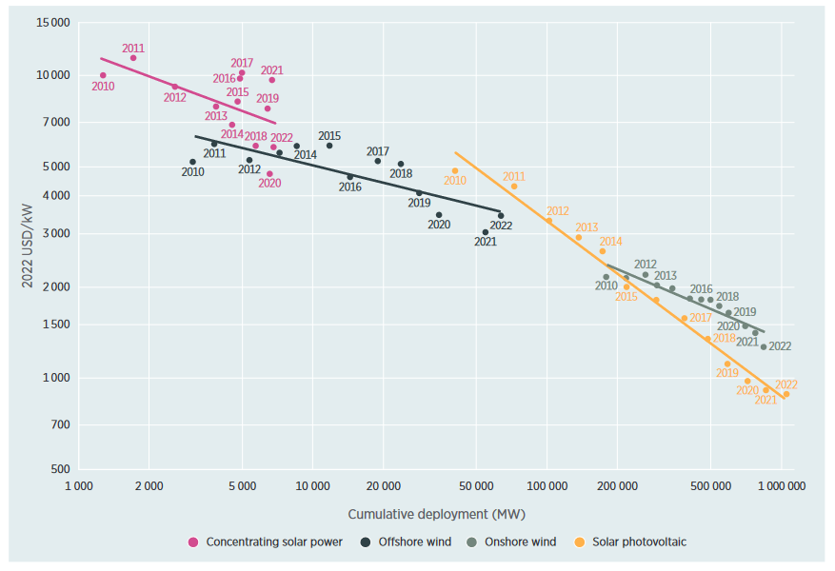
Wright’s law in action

Slide 7
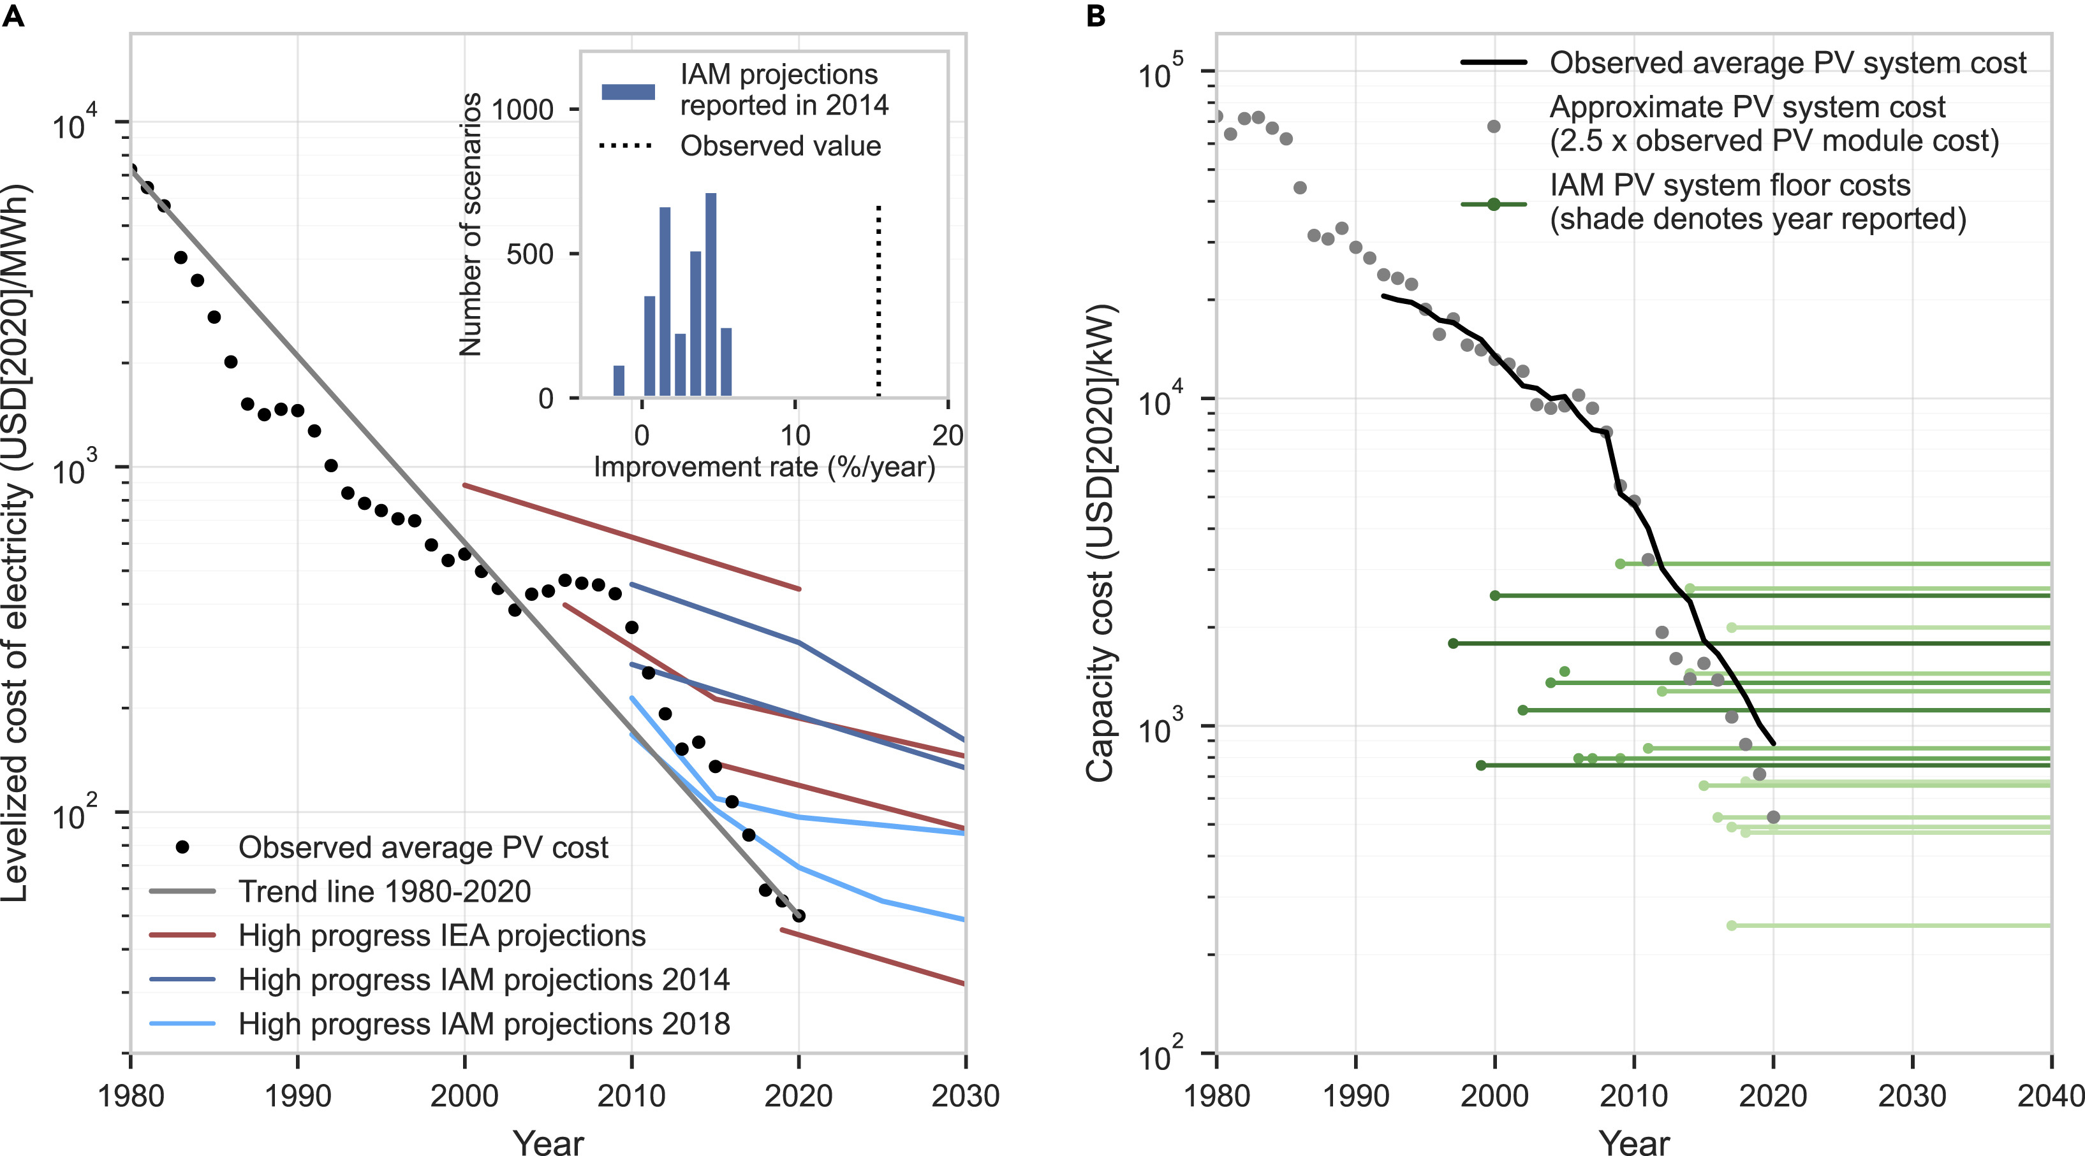
Assumption: no floor costs

Slide 8
Sector-specific assumptions
Power
Dispatcher decides on capacity factors and curtailment
Cost-supply curves for fossil fuel and land availability & cost
Heating
Learning-by doing applied to efficiency & upfront costs
Air-air heat pumps only for space heating
Cars
Decisions (fitness) based on logarithm of costs, to reflect stronger non-costs effects
Trucks
Limited data available: strong proxying

Slide 9
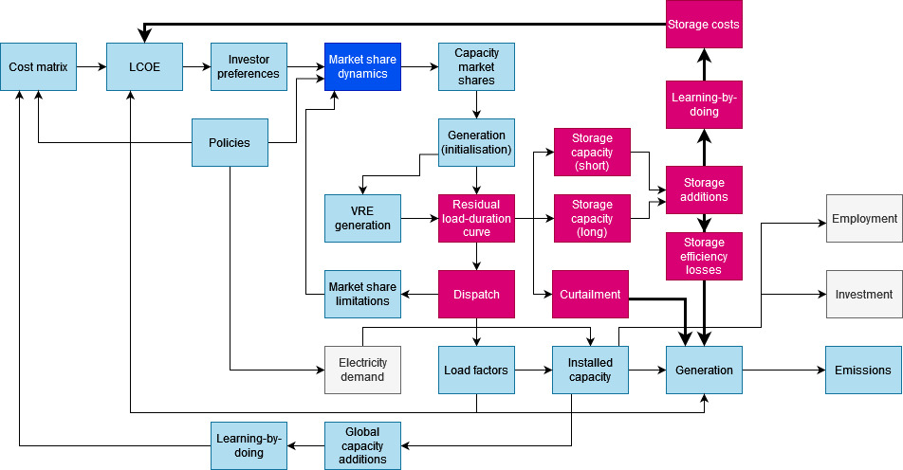
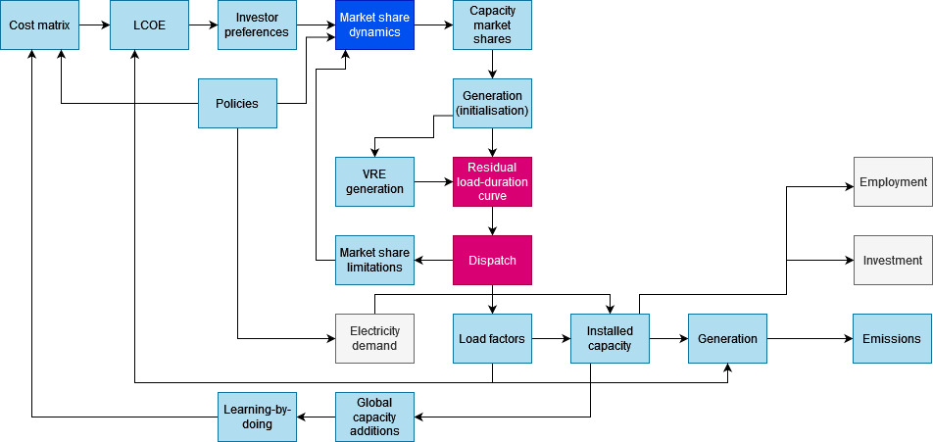
FTT Power: the block diagram

Slide 10
Policy levers
Policy | Effects | Mechanism
Carbon tax | FTT: Increases the cost of carbon intensive processes E3ME: Increases fossil fuel prices depending on carbon intensity and leads to substitution towards other energy carriers | Levelised costs
Energy/Material tax/rebates | FTT: Changes the costs of inputs and therefore the production costs E3ME: Changes energy prices and leads to substitution towards other energy carriers | Levelised costs
Subsidies on upfront investment | FTT: Decreases the net present value (NPV) of expenses and therefore the break-even price | Levelised costs
Market cap regulations | FTT: Prevents uptake up to a certain capacity level. If that level is zero, then it turns into a full phase-out | Market shares
Strategic investment | FTT: Forced uptake of technologies through government mandates | Market shares
Energy efficiency investments | E3ME: Lowers energy demand at the cost of higher investments | Both (levelised costs via cost-supply curves, market shares via other policies)
Equilibrium models often only include price-based incentives with the expectation of a fully rational and marginal response to such incentives

Slide 11
Policy implications

Slide 12
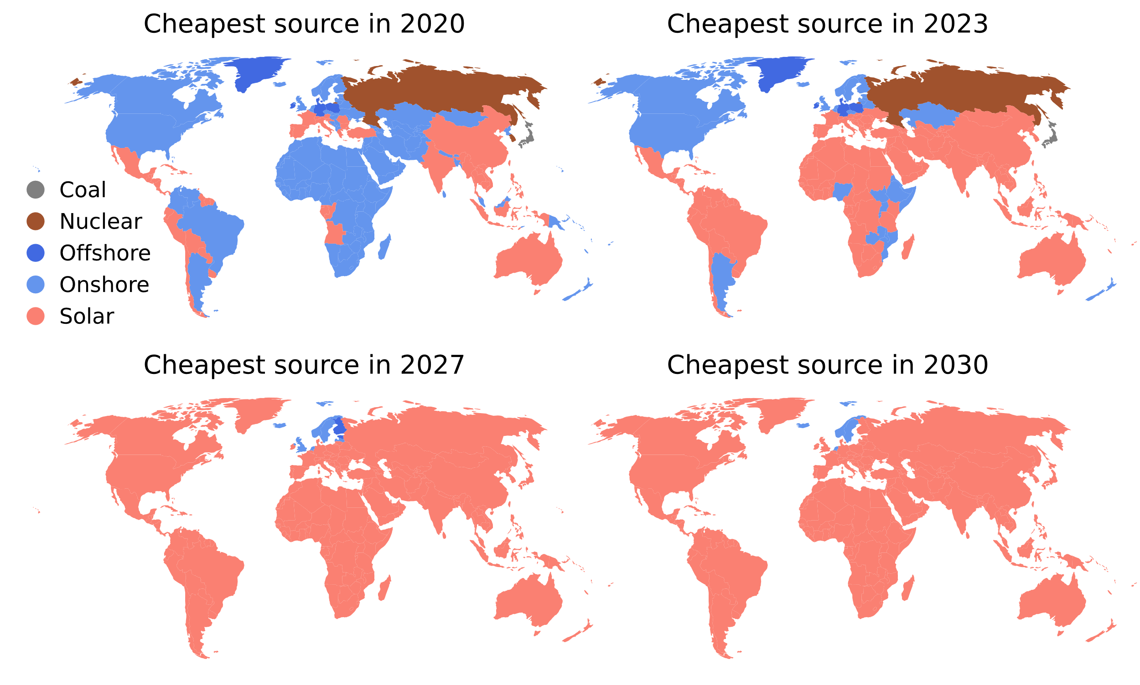
Non-cost policies likely more effective in power
Solar set to become cheapest almost everywhere
  Merchant risk → unpredictable power prices require FiT/CfD
  Flexibility (storage, transmission etc)
  Explicit support wind for reliability
Nijsse et al, Nature Communication

Slide 13
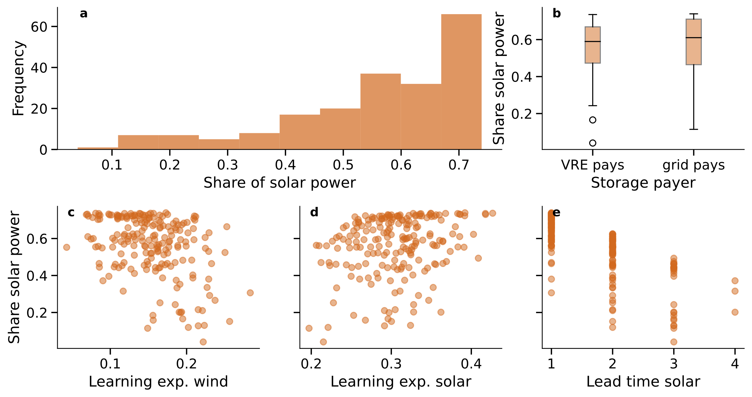
Avoid delays in getting connected grid (e)

Slide 14
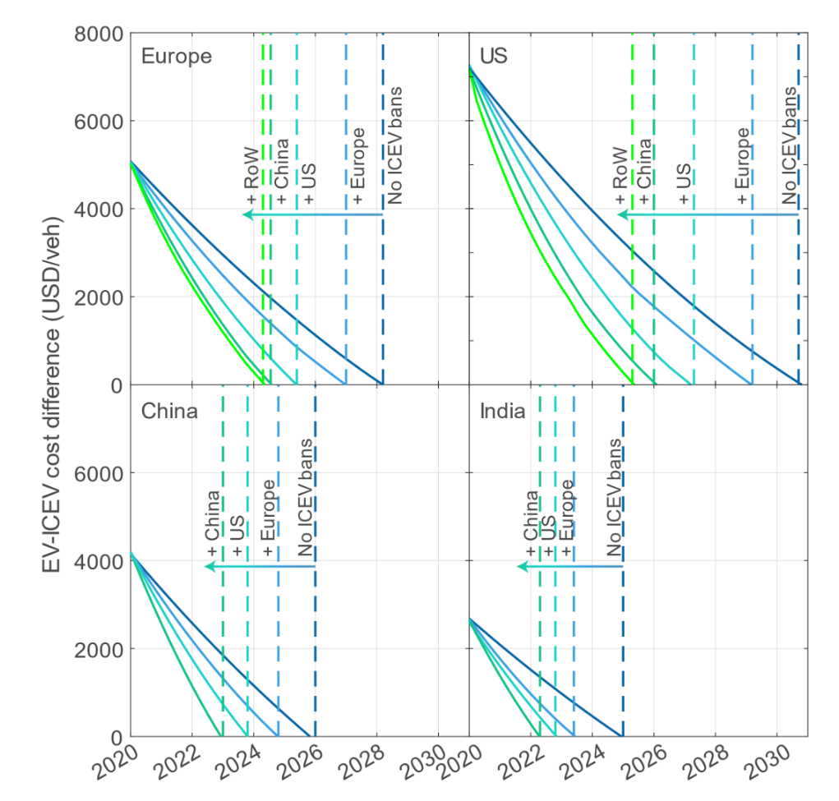
Policy coordination
Difference in EV cost vs ICE cost, assuming ambitious policies in major car markets
Policy in China, US and Europe has disproportionate effect other markets
Lam & Mercure (2022): Evidence for a global electric vehicle tipping point, preprint.

Slide 15
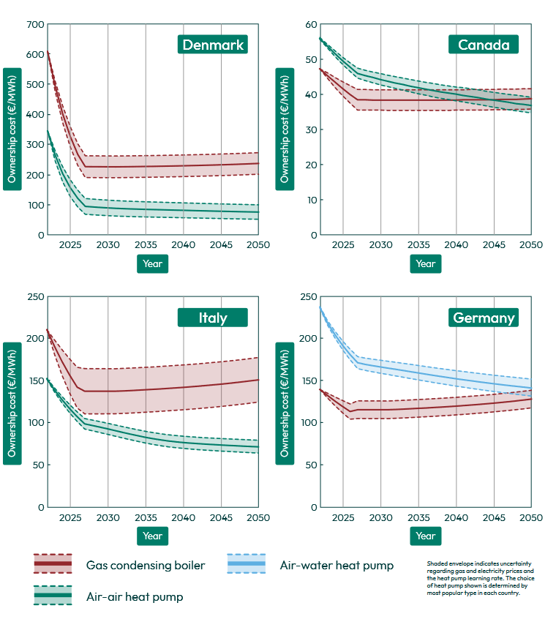
Strong policy needed in countries with boilers
Furnaces can be replaced by cheaper air-air HPs.
Boilers are replaced by more expensive air-water HPs.
Costs can be brought down via deployment and insulation (via higher efficiencies)
Lynch et al (2023): Crossing the tipping point. Heat Pumps Case Study.

Slide 16
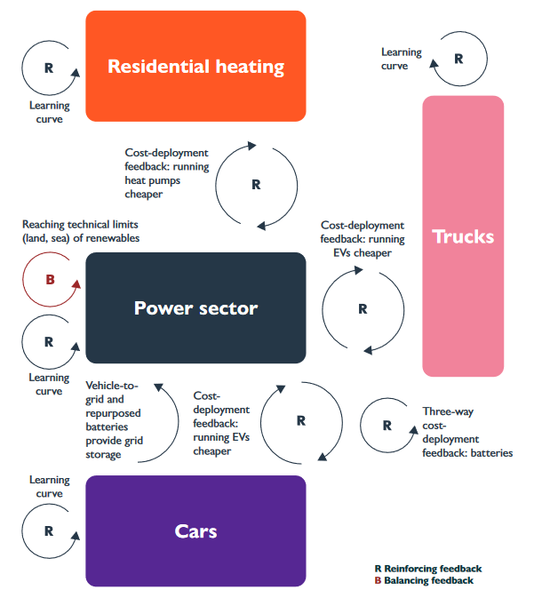

Sectoral coupling
Four models of technology competition, data for up to 71 world regions
Key interactions in terms of prices, demand, sector coupling technologies

Slide 17
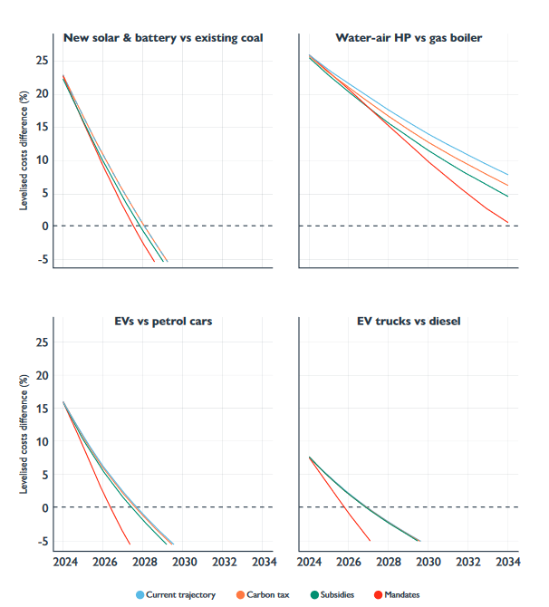
Mandates effective for bringing down costs
The cost parity point (or tipping point) of prices without taxes or subsidies is brought forward via induced innovation
Mandates have the strongest effect on deployment, and therefore bring costs down fastest

Slide 18
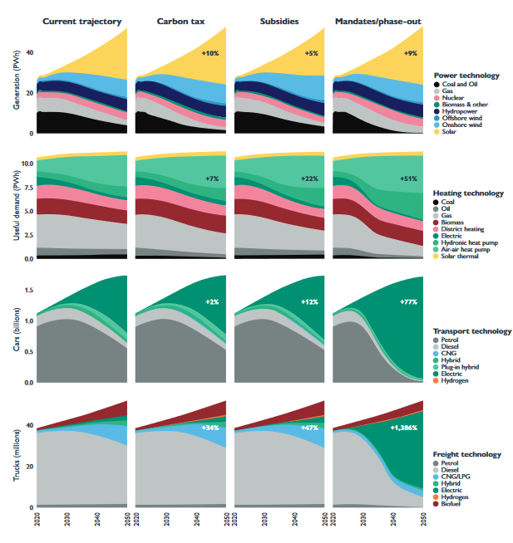
Deployment policies
In the power sector: carbon tax and mandates both highly effective
In consumer-facing sectors, carbon taxes are least effective. Consumers care strongly about upfront costs
In the early transition (trucks), policy sequencing is key. Carbon tax only becomes effective when enough choice is created.

Slide 19
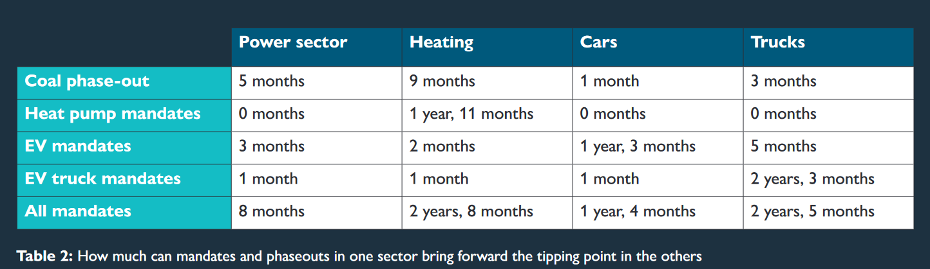
Cross-sectoral tipping effects
Two superleverage points show strong effects outside of their sector:
A coal phase-out (2035 or 2045, depending on income)
  drives down electricity bills
An EV mandate (no new fossil cars from 2035)
  Drives down battery costs and provides short-term storage

Slide 20
Strenghts and limitations
Key strengths
Comparing deployment policies at different stages of the transition
Finding a “cost-optimal” pathway
Other models are stronger
Evaluating policy coordination
Evaluating policy sequencing
Subnational electricity planning

