Slide 1
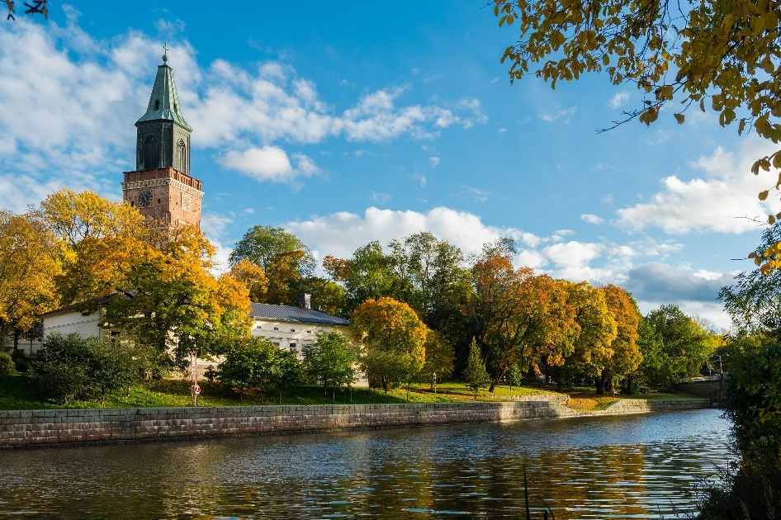
Transformative Innovation for Climate Adaptation - Peer Review
City of Turku
Relevant CC impact in the territory
Impacts relating to water
Heat and drought
Changes in ecosystems
Courtesy: DOI – OPM
Nov 2024
Notes:
Please see the notes below the slides for suggestions on how to fill the template for your territory.
“CC”: Climate Change
“CCA” (in subsequent pages): Climate Change Adaptation
Instructions:
Add the name of your territory on top + organisations involved in the peer review presentation – If needed, create additional slide.
Make a shortlist of the key CC impacts in your territory that you want to discuss -– If needed, create additional slide.

Slide 2
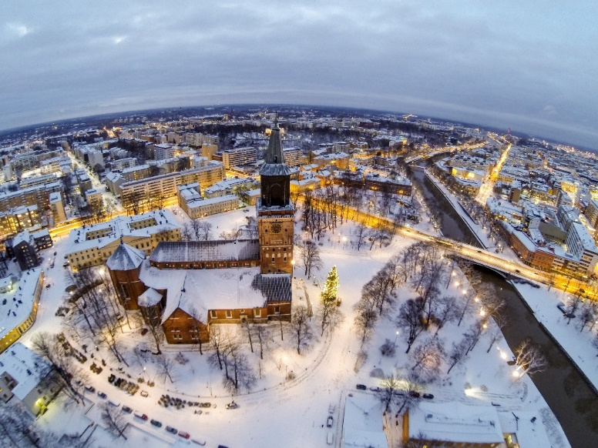
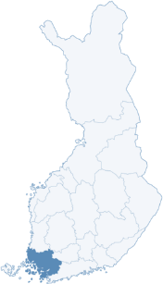
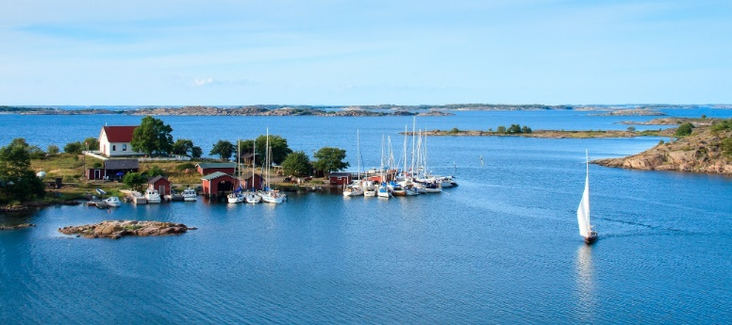

Profile of the Territory
Southwest Finland is Finland’s third most populous region, with nearly 500,000 inhabitants
Turku is the capital of the region, and also a former capital and the oldest city in Finland (AD 1229)
200,000 residents in the City of Turku, 350,000 in the Turku region
Two universities and four universities of applied science
40,000 students in higher education and 11,000 in vocational
City of Culture, Creative, Maritime, Bio and Diagnostic industries
Active Civic Society
Dense Urban Structure
Rich natural environment and Archipelago

Slide 3
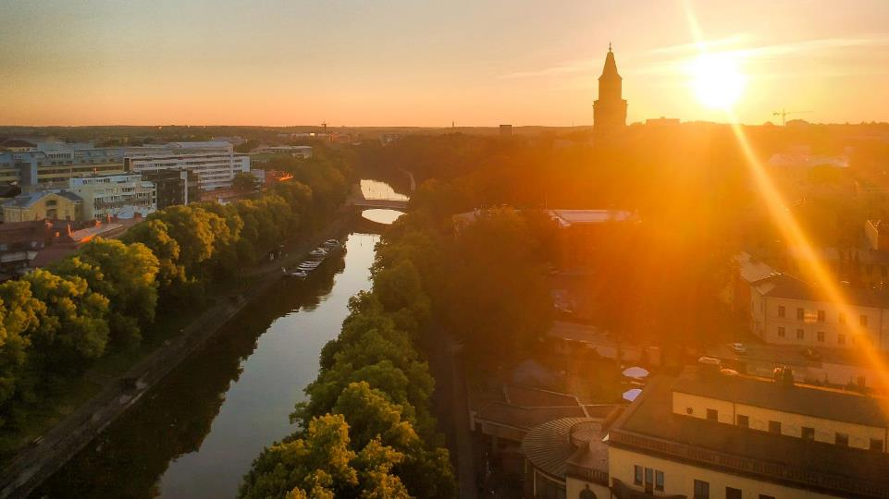


Biodiversity and rich natural environment
Objective
Sustainable
use of
natural
resources
Turku will be one of the world’s leading climate and nature cities
Turku City Strategy
Climate Positive
From 2029 onwards
City of Turku supports the Sustainable Development Goals

Slide 4


Climate Responsibility of Turku
GHG emissions from Turku area have already been been reduced
Glogal warming continues on riskful level, even while global climate policy is advancing.
Turku Climate Plan has been evaluated and upgraded (incl. mitigation, risks and impacts and adaptation).
-55 %
Turku’s GHG emissions are already the lowest of cities’ in Finland and are being reduced fastest.
from the level of 1990 by 2020.
From the top levels of 2000’s the reduction is -60 %.
City of Turku Climate Plan 2029 (EU SECAP) steers the Climate policies and actions of the whole city group
(City Council 16 May 2022).
Turku invests to Climate Action.
Energy use of fossil coal has been ended during 2022.*
GHG emissions per capita in 2020 t.-CO2-ekv
without industry emissions, CO2 Report 2022)
* Excluding crisis situations

Slide 5
State of Play of CCA & Innovation Strategies
CCA strategy (ies)
Turku Climate Plan 2029
National Climate Change Adaptation Strategy 2030
(Southwest Finland’s Climate Roadmap 2030 focuses on mitigation, no regional CCA strategy)
Innovation strategy (ies)
Southwest Finland's Smart Specialisation Strategy
Southwest Finland's Research and Innovation Roadmap
Notes:
CCA: Climate change adaptation
Instruction: summarise the main features of your CCA and Innovation ecosystem from your territory’s case study report – see Chapter 2.3 (Flag if you have other observations than those listed in the case study)
Add other pages if needed

Slide 6
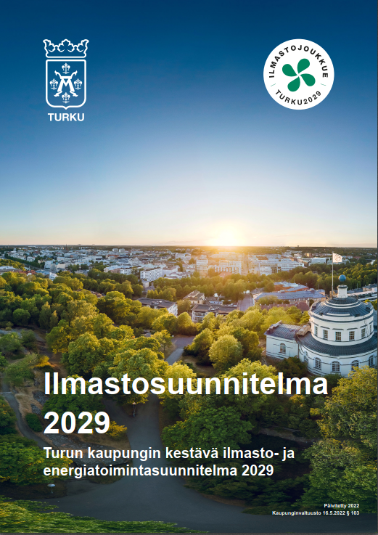
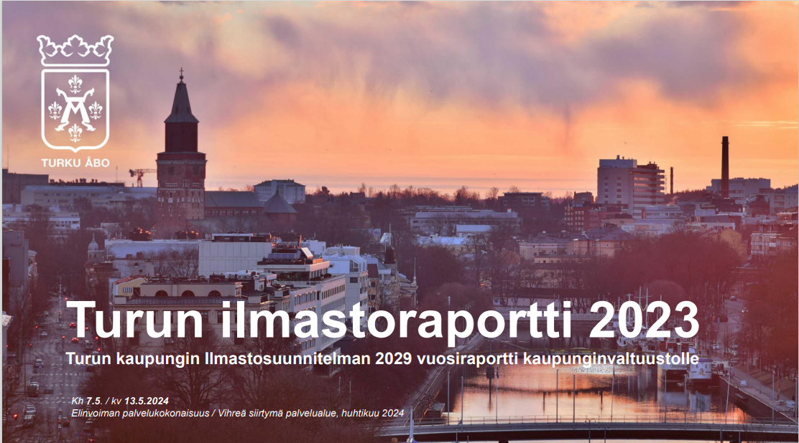
Turku Climate Plan 2029 and climate targets
Turku City Council decided on the strategy on 16 April 2018. The main target of climate policy in accordance with the city strategy is a carbon neutral city area by the year 2029.
In order to meet the target, the Turku area strives to reduce greenhouse gases by 90 per cent compared to the 1990 level by year 2029. This target will be reached through milestones that are set for each council term.
From 2029 onwards, Turku strives to be a climate positive area with negative net emissions.
Turku prepares for climate change as comprehensively as possible and the city is developed to better sustain the change.
Turku implements strong climate policy and strives to be an internationally recognised pioneer and developer of sustainable solutions and expertise.

Slide 7
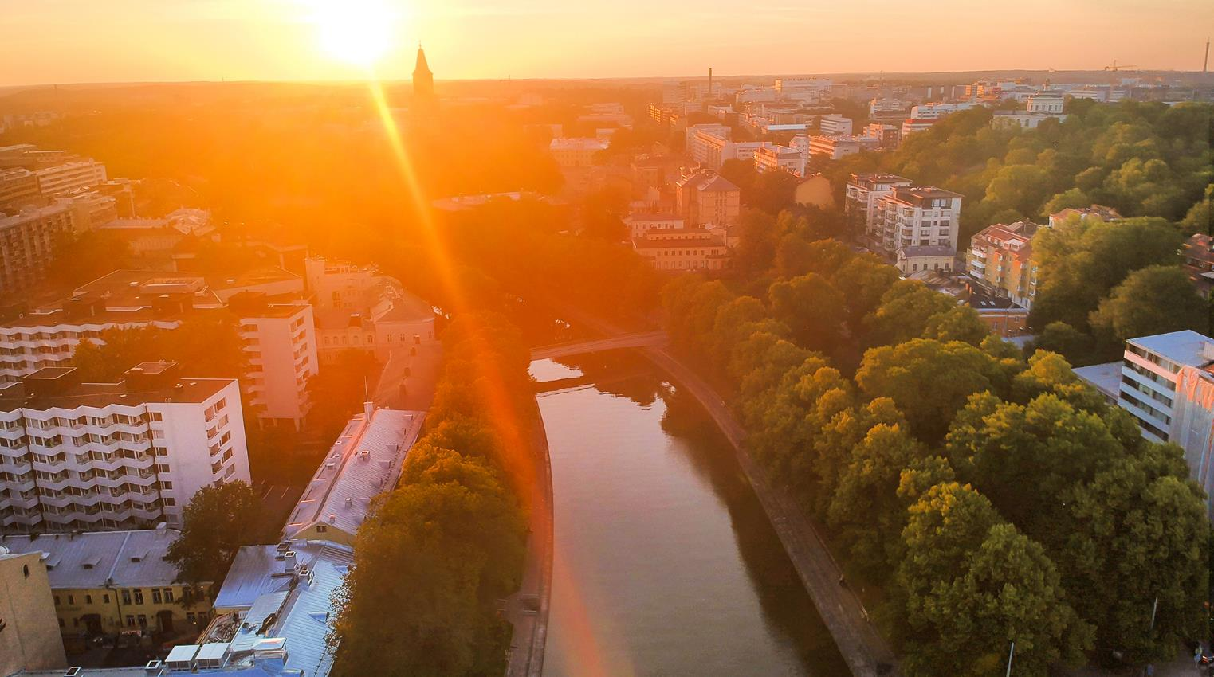
Sustainable mobility
Turku is changing
the climate
for the better
Mitigation and adaptation
Circular economy
and resource wisdom
Sustainable urban structure
1.5-degree lifestyle
Strengthening carbon sinks
City
organisation’s climate responsibility
Ways of achieving carbon neutrality
in 2029.
and helping us
all do the same
Carbon-neutral energy system
Nature-based solutions and biodiversity

Slide 8
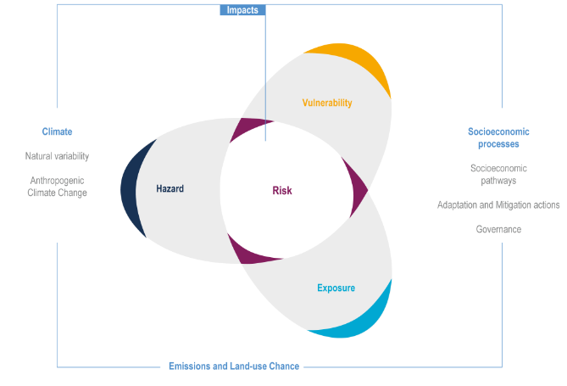
Risk and vulnerability assessment
As part of Mayors' Sustainable Energy and Climate Action Plan, an extensive analysis of climate change risks and vulnerabilities was carried out in Turku
It was possible to identify three clear main risks that pose a threat to Turku now and in the near future:
  risks related to water bodies and water management,
  risks caused by changes in ecosystems, and
  risks related to heat and drought.
Figure: IPCC

Slide 9
Turku has recognised three main risk categories
Water and water management
Changes in ecosystems
Heat and drought
Risks related to water bodies and water management include rains and heavy rains, floods, runoff waters, rise of sea level and storms.
Risks related to water bodies and water management are naturally linked to the geographic location of Turku on the coast and the clay soil that slows down the absorption of water.
Rains in the Turku area were estimated to develop in a way that winter rains increase while summers will be drier.
The lack of green areas and absorption surfaces in the urban area contribute to the problem too.
Changes in species and their effects on forestry and agriculture were identified as one example, including changes in tree species in forests. There will be effects to the urban nature too.
For instance, the spreading of new pests and plant diseases in the area is even likely.
Changes in ecosystems will also result in diminished biodiversity in the Turku area.
Prolonged periods of heat and drought → Effects to agriculture, heath and well-being, wildfires etc.
Vulnerable groups
Urban heat island phenomenon in the city.

Slide 10
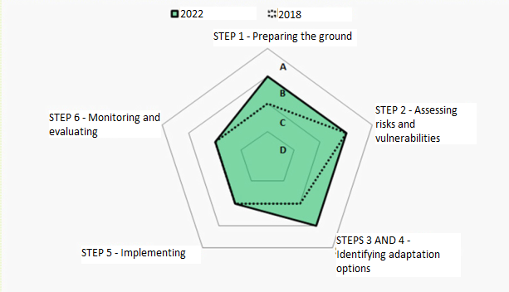
Adaptation scoreboard
Self-assessment together with Sitowise experts
A = Taking the lead (over 75 % completed)
B = Forging ahead (50-75 % completed)
C = Moving forward (25-50 % completed)
D = Not started or getting started (less than 25 % completed)
Future challenge is especially to strengthen the overview and coordination of the adaptation, as well as ensuring the competence and financial support in the city’s organization.
Turku Climate Plan 2029

Slide 11
Administration of the City of Turku
CHIEF OF STAFF
Central administration
Management Support ● Shared Services ● Integration
SERVICEs
CHILDREN AND YOUNG PEOPLE
Youth Services
Urban environment
Urban Planning
and Land Property
Urban
Construction
Permits and
Monitoring
Mobility Services
Geographic
Information and
City Surveying
EDUCATION
Early Childhood Education and Care
Basic Education
General Upper Secondary Education
General Adult Education and Training
Vocational Education
Swedish Language
Education
Shared Services
Culture
Library Services
Museum Services
Turku Philharmonic Orchestra
Culture Promotion
Sports
Sports Services
Sports Facilities Management
Activating
Physical Exercise
BUSINESS AND ECONOMIC DEVELOPMENT
Business Services
Spearhead Projects
Strategic Land Use,
Mobility and
Housing Policy
Green Transition
Employment Services
Event Services
Children and Young people’s services ensures that all measures and services affecting children and young people are managed in
an interactive manner.
Companies and organisations owned by Turku

Slide 12
The Smart Specialisation Strategy of Southwest Finland
Priority growth areas:
Blue economy and renewing industry
  Maritime industry (shipbuilding)
  Clean and resource-wise solutions
Innovative food chains
  The food products and the food product know-how in blue and green bioeconomy
  Regional and diversified co-creation of food products and experiences,
  Digitalisation and technology in the development of sustainable food
Life science and health technology
  drug development and diagnostics
  Imaging
  health technology and health data analytics
  production of company, test, and support services

Slide 13
Southwest Finland R&I Roadmap
Blue economy & renewing industry
Green transition
Digitalisation
Health and Wellbeing
Innovative food chains
Life sciences & health technology

Slide 14
Dimensions of transformative innovation
Directionality: Defining goals and scope of strategic actions to reflect societal challenges with endorsement at highest political level
Articulating instrument portfolios & defining synergies between funding sources: establishing all-encompassing instrument portfolios addressing whole innovation cycle and various aspects of CCA, paired with adequate funding.
Ensuring cross-domain synergies: favouring whole-of-government approaches to ensure greater horizontal coherence between various thematic policy areas resulting in coordinated mixes of instruments.
Increasing breadth & depth of stakeholder involvement: working towards social acceptance of new solutions and shaping of innovative developments, as well as improving public trust, opening up public debates, managing diverse and sometimes conflicting views over alternative pathways.
Setting up effective multi-level governance models: maximising potential of vertical synergies, recognising complementary roles for various governance levels - local, regional, national and EU;
Making room for experimentation: providing adequate space for risk-taking and creativity - ensuring a risk-tolerant environment to facilitate development of new solutions.
Securing high levels of policy intelligence and strategic capacity: building strong evidence-based policy learning capacities, based on a solid knowledge base and skills to manage transitions.
Notes:
This is a slide with fixed content meant to remind the participants the key dimensions of transformative innovation for climate resilience.
Instruction: in the next slide, you will have to select a minimum of 3 from this list

Slide 15
Dimensions (minimum of 3) perceived as most important to discuss at the peer review
Directionality
Articulating instrument portfolios & defining synergies between funding sources
Ensuring cross-domain synergies
Increasing breadth & depth of stakeholder involvement
Setting up effective multi-level governance models
Making room for experimentation
Securing high levels of policy intelligence & strategic capacity
(for each of them the following slides will cover “State-of-play”, “Bottlenecks” and “Ways forward”)
Notes:
Instructions:
Among the 7 dimensions initially marked with grey colour, mark with black colour a minimum of 3 (or more) most relevant aspects that you would like to discuss during the peer-review session (in this slide the remaining dimensions stay in grey as they will not be covered in the peer review).
(In the subsequent slides you will be asked to provide (for each of the 3 -or more- selected dimensions) the questions/aspects you want to discuss, broken down in 1/ “State-of-play”, 2/ “Bottlenecks” and 3/ “Ways forward”)
In order to make the discussion at the workshop as useful as possible, it is important to move out of the ‘classical’ presenting mood and aim at a more concrete approach to the issues that need to be addressed while establishing / implementing / improving your strategy. For this reason it is important to define well each of the 3 questions/aspects (“State-of-play”, “Bottlenecks”, “Ways forward”) that would act as a ‘red thread’ in your presentation and consecutive peer-review session.
This in turn would stimulate discussion on:
i) what the peers think are the underlying critical factors concerning the issues that you want to discuss
ii) suggestions for policies/measures to address these issues.
(All discussions are foreseen in plenary, but depending on the number of participants the audience may be divided into sub-groups addressing each of the issues that you want to address – If needed we will come back to you on this aspect)
Please remember that the more targeted these questions are, the more concise and relevant feedback you will get. By presenting the questions up front, you allow your peer critical friends to keep them in mind while you give your presentation. The questions should be repeated at the end of the presentation. Questions of a very general character can be made relevant for your specific region only if you give related information in your presentation.
When preparing the presentation you might want to go through the rest of slides of this template and try to steer the information so it provides a logic to what you want to discuss, what the issues at hand are. This template provides you with suggestions for areas that can be relevant to bring up in order to explain your strategy and the issues. You may feel that you want to add some slides, which is good, but please bear in mind that there is only +/- 30 minutes for presentation, which on average is something like 15 slides, so try not to make the presentation too long.

Slide 16
Selected questions/topics for discussion with peers
Directionality:
How can climate change adaptation (CCA) be strengthened and integrated across different sectors (urban planning, transport, housing etc.) within city strategies, including setting appropriate and measurable targets?
How to make implementation more effective by using target indicators? Concrete examples from other cities?
------------------------------------------
Increasing breadth & depth of stakeholder involvement:
How can stakeholder participation, particularly that of young people, be more effectively integrated into climate change adaptation (CCA) efforts?
How can Turku enhance long-term cooperation with key actors, such as businesses, to strengthen adaptation efforts beyond single projects?
------------------------------------------
Notes:
Instructions:
The questions/topics you wish to discuss (by dimension) are repeated in this last slide, and stay on the screen during the discussion.
Here again the example above show 3 examples of dimension but you will substitute them with the dimensions of your choice (3 or more)

Slide 17
1/ Directionality:
1. How can climate change adaptation (CCA) be strengthened and integrated across different sectors (urban planning, transport, housing etc.) within city strategies, including setting appropriate and measurable targets?
2. How to make implementation more effective by using target indicators? Concrete examples from other cities?
State-of-play:
CCA is included in the city strategies:
Turku Climate Plan 2029, including CCA:
  understanding risks; reinforcing risk management; investments to enhance risk resilience; developing disaster preparedness -> concrete measures
Turku City Strategy:
  "the city is prepared for changes caused by global warming and extreme weather phenomena. -- Biodiversity, rich urban and local natural environment as well as carbon sinks in the area have increased even though the population has increased. The well-being of the local natural environment improves the quality of life of residents and offsets the effects of intensified weather phenomena.“
Climate budget: applies EU taxonomy of sustainable finance
Bottlenecks:
  Clear measurable targets?
  Greater focus on climate change mitigation currently
  The city has a number of strategic documents which do not have a clear hierarchy. The strategies are also sectorally siloed, which leads to situations that implementation of e.g. CCA targets in different divisions' and units' operations
Planned ways forward (if any planned at the moment):
  Participating in national process and discussions regarding target-setting and CCA indicators
  Updating the Turku Climate Plan in 2025; a bigger emphasis to CCA
  City- region cooperation
Notes:
Instructions:
In each of the 3+ shortlisted dimension to discuss, formulate the questions you would like to address with your peers (note that “State-of-play” does not necessarily trigger questions but it can contextualise why you decided to chose your 3+ dimensions).
In the slide above, the dimension DIRECTIONALITY is given as an example. Modify it if you want to address another dimension
More than 1 question can be formulated for each of the 3 topics to discuss (“State-of-play”, “Bottlenecks”, “Ways forward”), but keep in mind the time limitation
The questions should be repeated/summarized at the end of the presentation (slide 13).
Questions of a very general character can be made relevant for your specific region only if you provide enough related information in your presentation.

Slide 18
2/ Increasing breadth & depth of stakeholder involvement
1. How can stakeholder participation, particularly that of young people, be more effectively integrated into climate change adaptation (CCA) efforts?
2.How can Turku enhance long-term cooperation with key actors, such as businesses, to strengthen adaptation efforts beyond single projects?
State-of-play:
Climate Team for the companies (climate change mitigation; networking, knowledge sharing…)
Climate Action Cards for the companies
Climate action groups (incl. CCA)
Good cooperation with the Universities
Bottlenecks:
How to capture residents’ attention and engage them in the adaptation work?
How will different stakeholders understand the urgency and the meaning of CCA?
What would be the most appropriate and rewarding ways to participate?
Planned ways forward (if any planned at the moment):
Engaging stakeholders in projects relevant to CCA
Linking engagement work to climate adaptation
Notes:
Instructions:
Same as previous slide on the question(s) related to the 2nd dimension that you would like to discuss with your peers.
In the slide above, the dimension ARTICULATING INSTRUMENTS PORTFOLIOS is given as an example. Modify it if you chose to address another dimension
More than 1 question can be formulated for each of the 3 topics to discuss (“State-of-play”, “Bottlenecks”, “Ways forward”), but keep in mind the time limitation
The questions should be repeated/summarized at the end of the presentation (slide 13).
Questions of a very general character can be made relevant for you specific region only if you provide enough related information in your presentation

Slide 19
Ways Forward
For more effective TI4CR process according to the suggested steps in the Case study report and the peer-discussion, the following “Ways forward” are feasible in the territory:
Directionality:
  Participating in national process and discussions regarding target-setting and CCA indicators
  Updating the Turku Climate Plan in 2025; a bigger emphasis to CCA
  City-region cooperation
Increasing breadth and depth of stakeholder involvement:
  Engaging stakeholders in projects relevant to CCA
  Linking engagement work to climate adaptation
Notes:
Instructions:
In this slide please summarize the ways forward to address your questions on the 3 (or more) dimensions of your choice presented in slide 6, 7, 8
Replace the “Xxx” beside the selected dimensions listing feasible way(s) forward for each of the selected 3 dimensions
Optional: If time allows, you can also flag RELEVANT “ways forward” aspects outside the selected dimensions (eg. awareness raising or any other issues/aspects related to the role of transformative innovation in the CCA ativities in your territory).

