Slide 1
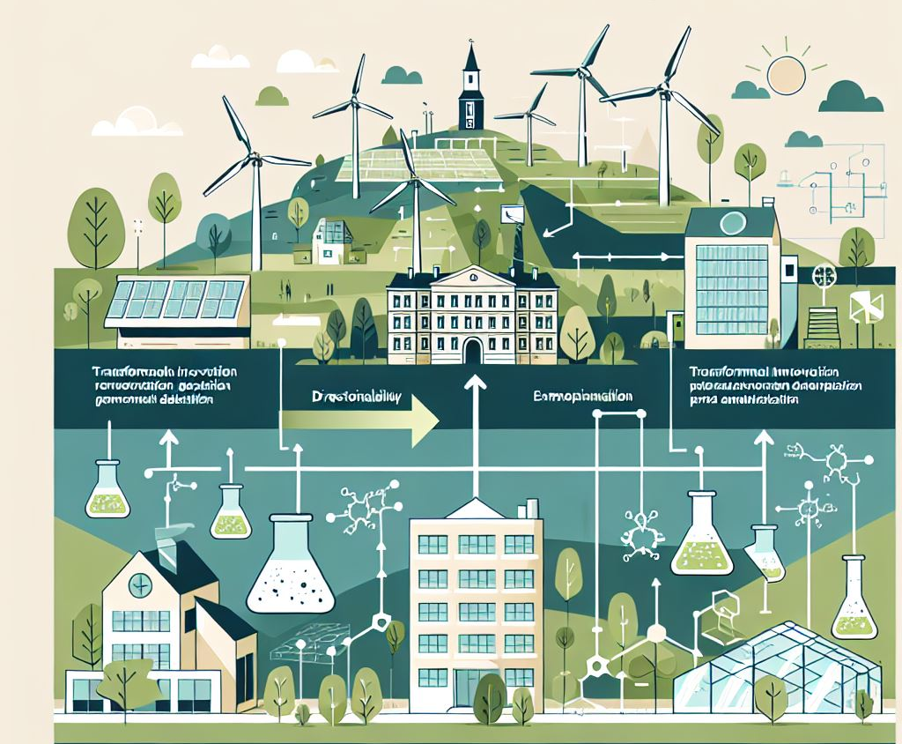


Transformative Innovation for Climate Adaptation
Peer Review
”Blekinge, Sweden”
The Region of Blekinge
Relevant CC impact in the territory
Floods (Rising sea level & Cloudbursts)
Droughts (low ground water levels)
2024-10-22

Slide 2
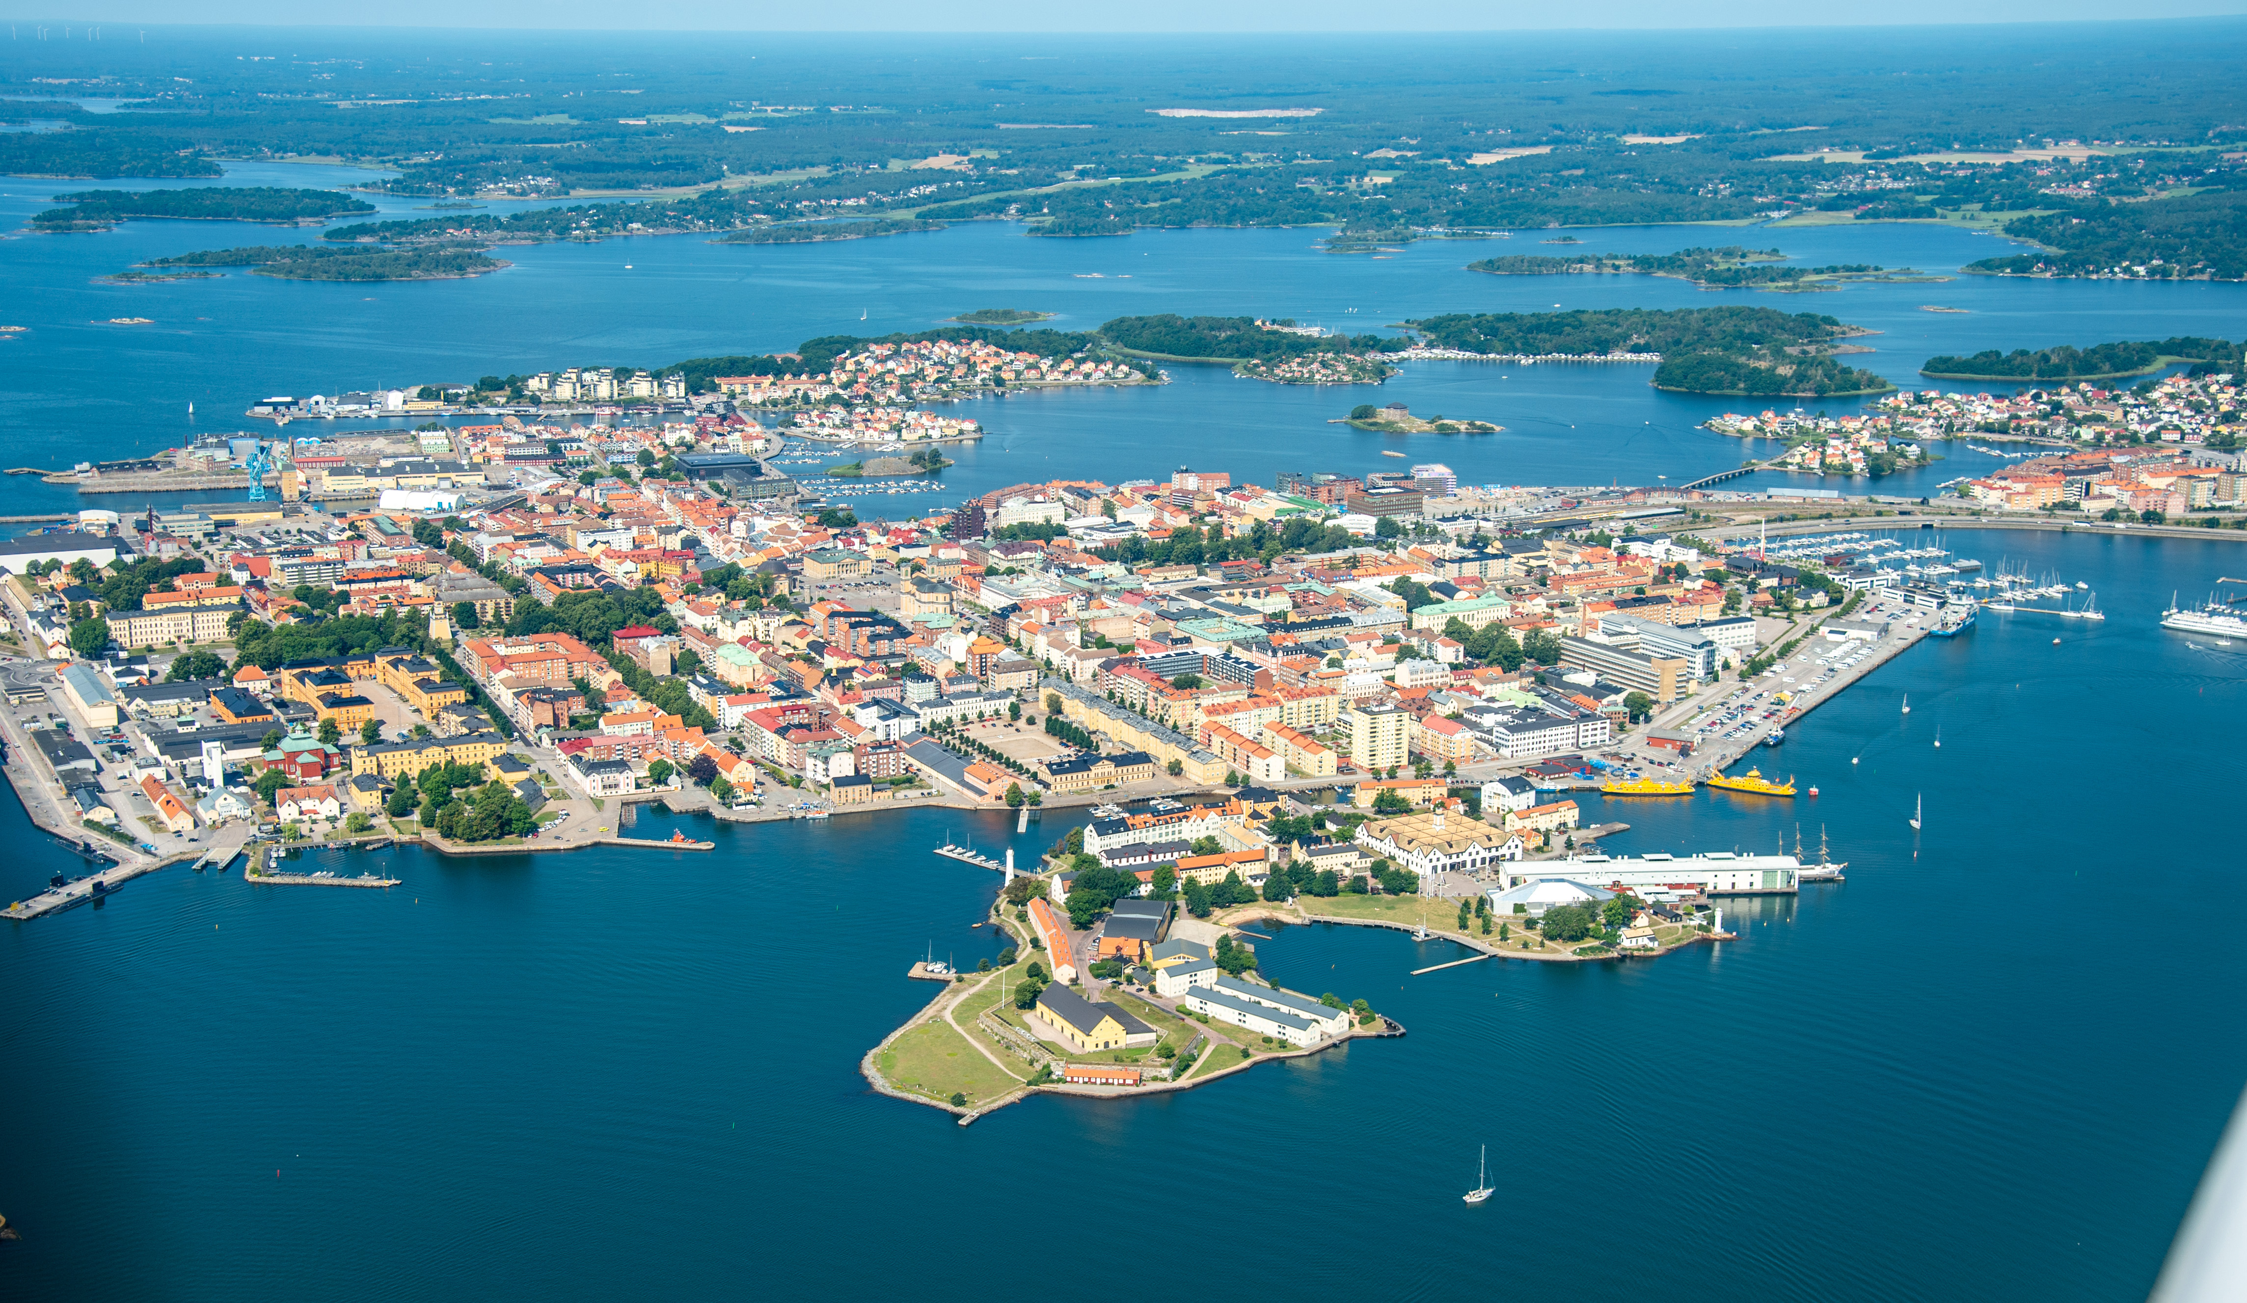
Profile of the Territory
Blekinge is a Swedish region on the Baltic Sea coast with an archipelago of over 1,000 islands and five municipalities.
With a long coastline and archipelago visibly affected by climate change.
Population: 160 000. Main city: Karlskrona
The region is facing pressing challenges related to climate change:
  depleted marine ecosystems – specifically near the coastline and in lakes/bodies of water affecting coastal communities
  decreasing groundwater levels
  increased risk of flooding.
Two municipalities in Blekinge – Karlshamn and Karlskrona – are on a list of 26 areas in Sweden facing a very high risk of floods due to sea level rise and climate change-related weather scenarios.

Slide 3
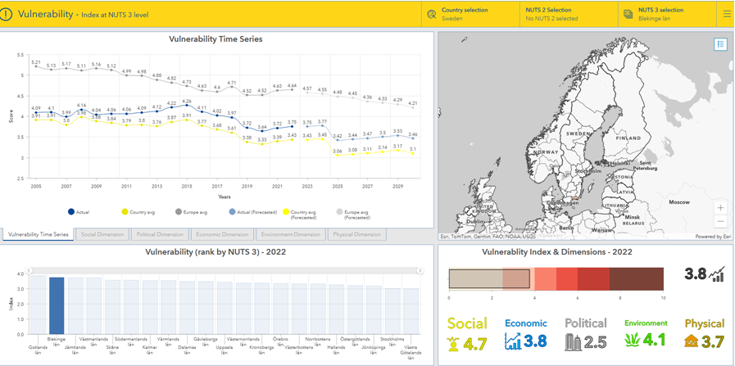
JRC
Risk Data Hub

Slide 4
Main CC Risks and Vulnerabilities
Average temperature is set to increase 2,7 degrees (mid scenario)
An increase in precipitation, and in extreme precipitation are in the forecast for the period
2017 – 2100
RISKS
Sea level rise and cloudbursts will have effect on cultural heritage, citizens, infrastructure, buildings and industry
Drought will have effect on industries water supply and relates to the already shallow ground water supply + agricultural and food production issues as well.
Heat stress will have effects on healthcare.
biodiversity loss, forest fires, and economic disruption are other issues.
VULNERABILITIES
Given it´s extensive coastline, Blekinge is particularly vulnerable to sea-level rise, which can lead to coastal erosion and increased flood risks.
Low land by the coast, holding most of the population, infrastructure and large industries.

Slide 5

State of Play of CCA & Innovation Strategies
CCA strategy (ies)
The Swedish National Expert Council, whose members are appointed by the national government, produces a report that serves as a knowledge base for creating…
… A national strategy for climate change adaptation, outlining goals, principles, organisation, responsibilities, monitoring, financing, and knowledge initiatives.
32 agencies and all county administrative boards are required to develop action plans for their climate change adaptation efforts and report on their progress
The municipalities are legally required to carry out a risk and vulnerability analysis for their area of responsibility and set their action plans
Each municipality in Blekinge has its own climate change adaptation strategy, and the municipalities are working with risk scenarios and related action plans (i.e. coastal preservation plan..)
Ultimately it is up to each landowner and real estate owner to carry out what is said in these strategies and action plans
Blekinge has included climate change adaptation in its smart specialisation strategy aligning CCA with innovation development
The S3 prioritises three areas: technology and marine technology, digitalisation and smarter communities, and missions, focusing on society's challenges such as climate change adaptation

Slide 6
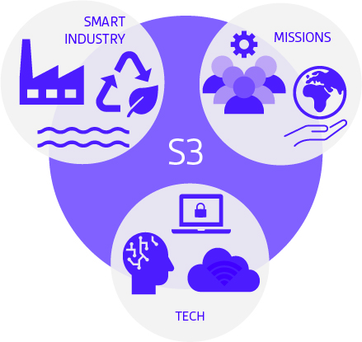
BLEKINGEs strategy for innovation and smart specialisation
Blekinge as a demo region
Design regional missions
Green transition and circular industry
Marine innovation (energy, resilience and security)

Slide 7

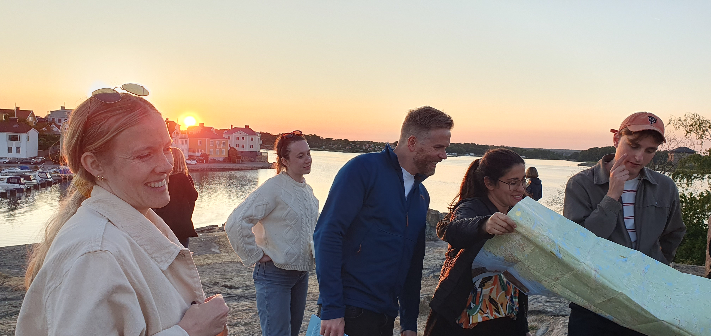
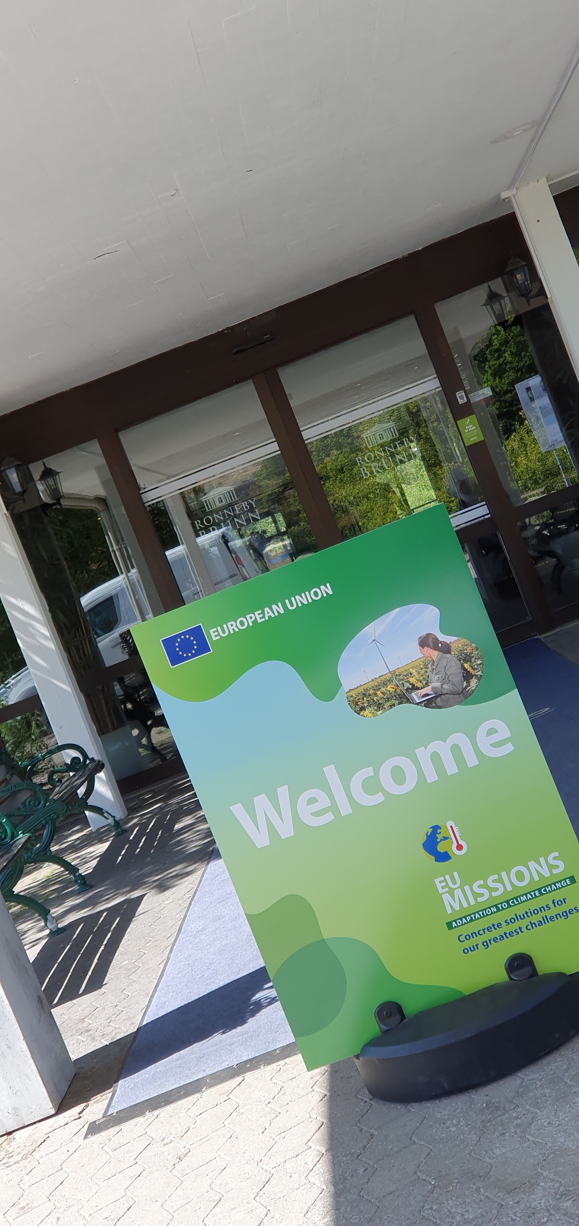
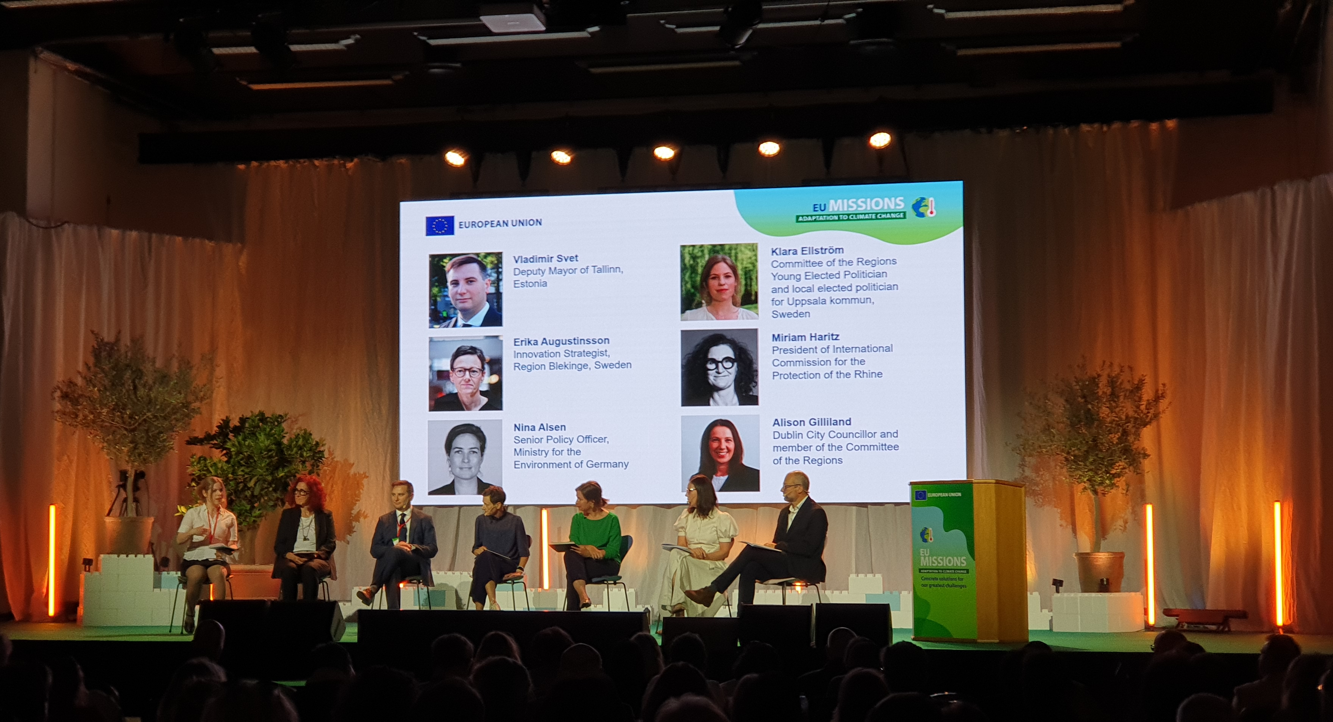
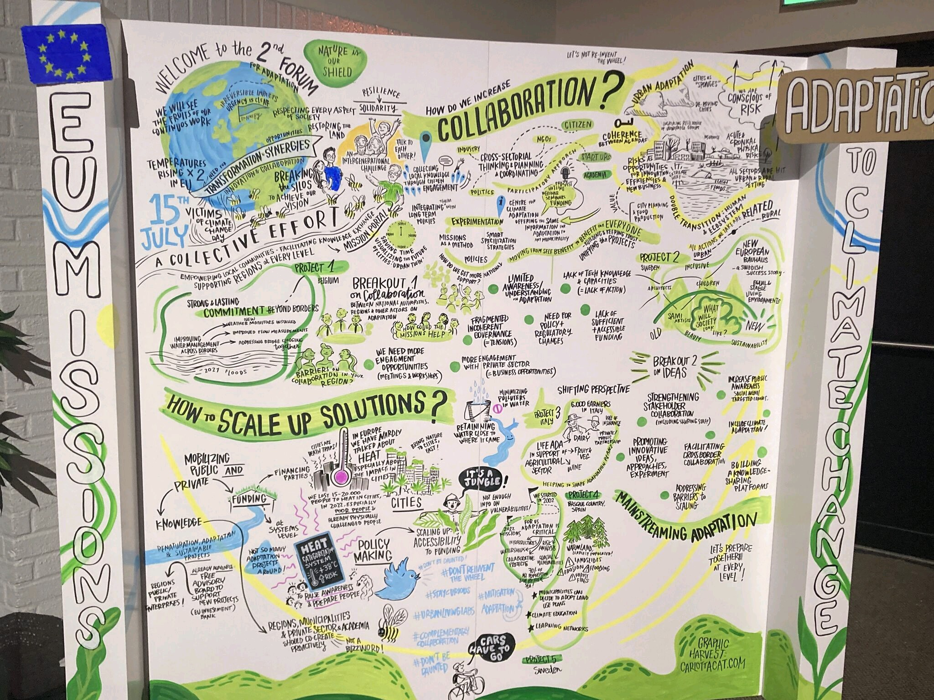
Notes:
Aligning missions and S3 enabled us to host the 2nd Mission Forum

Slide 8
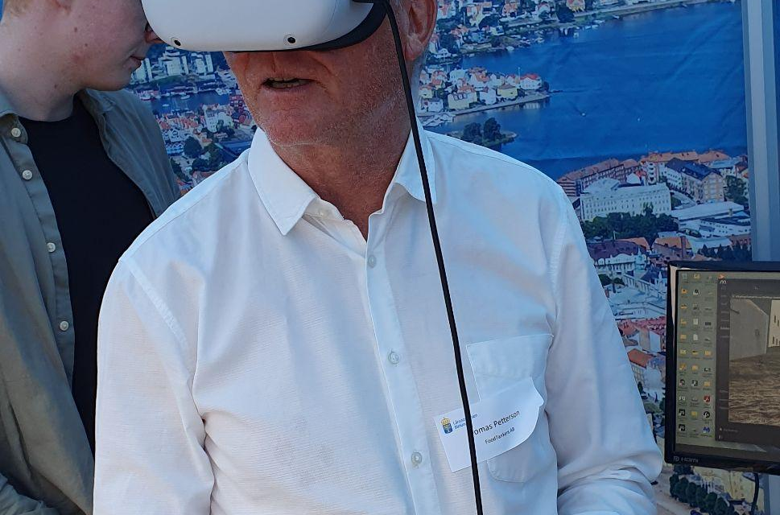
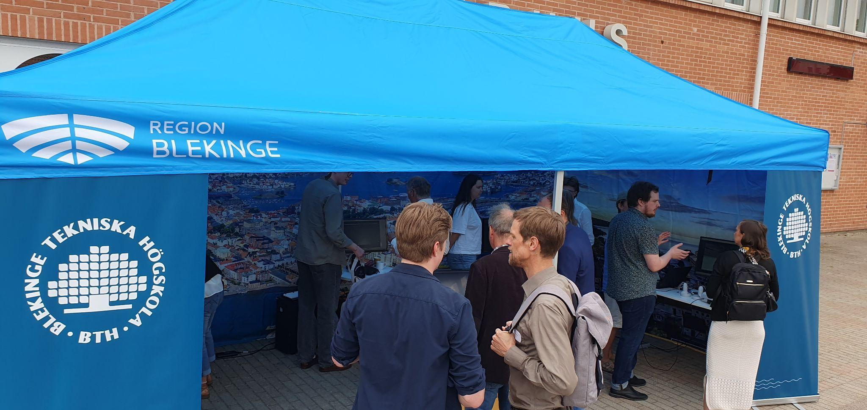
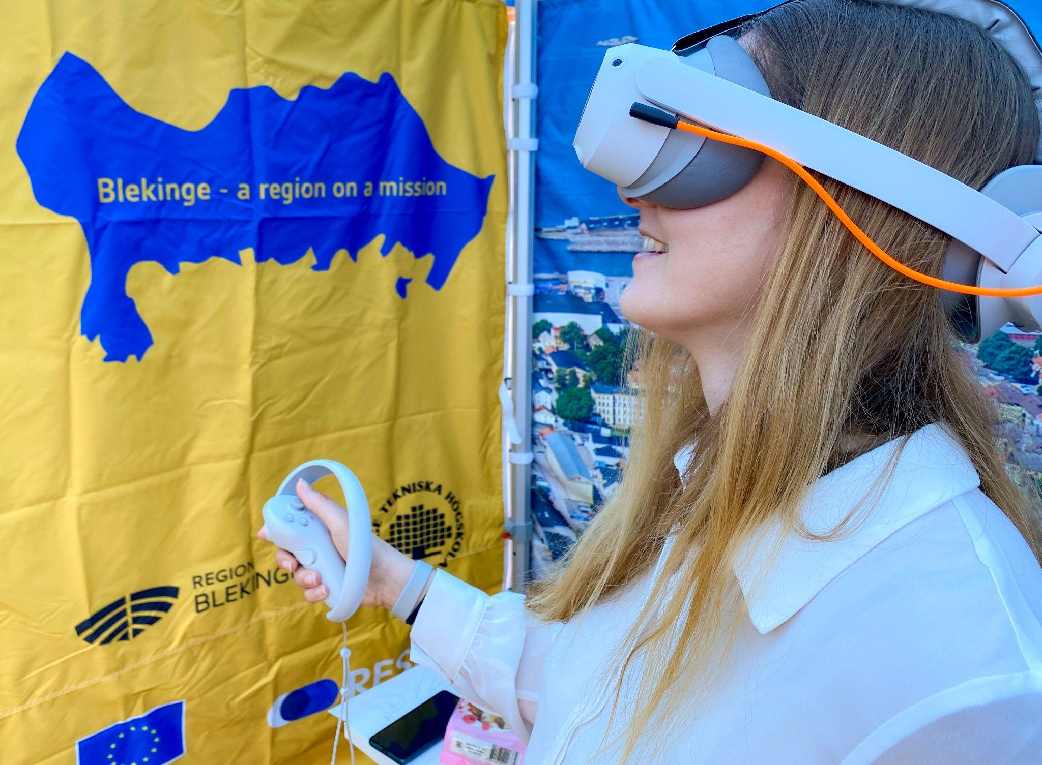
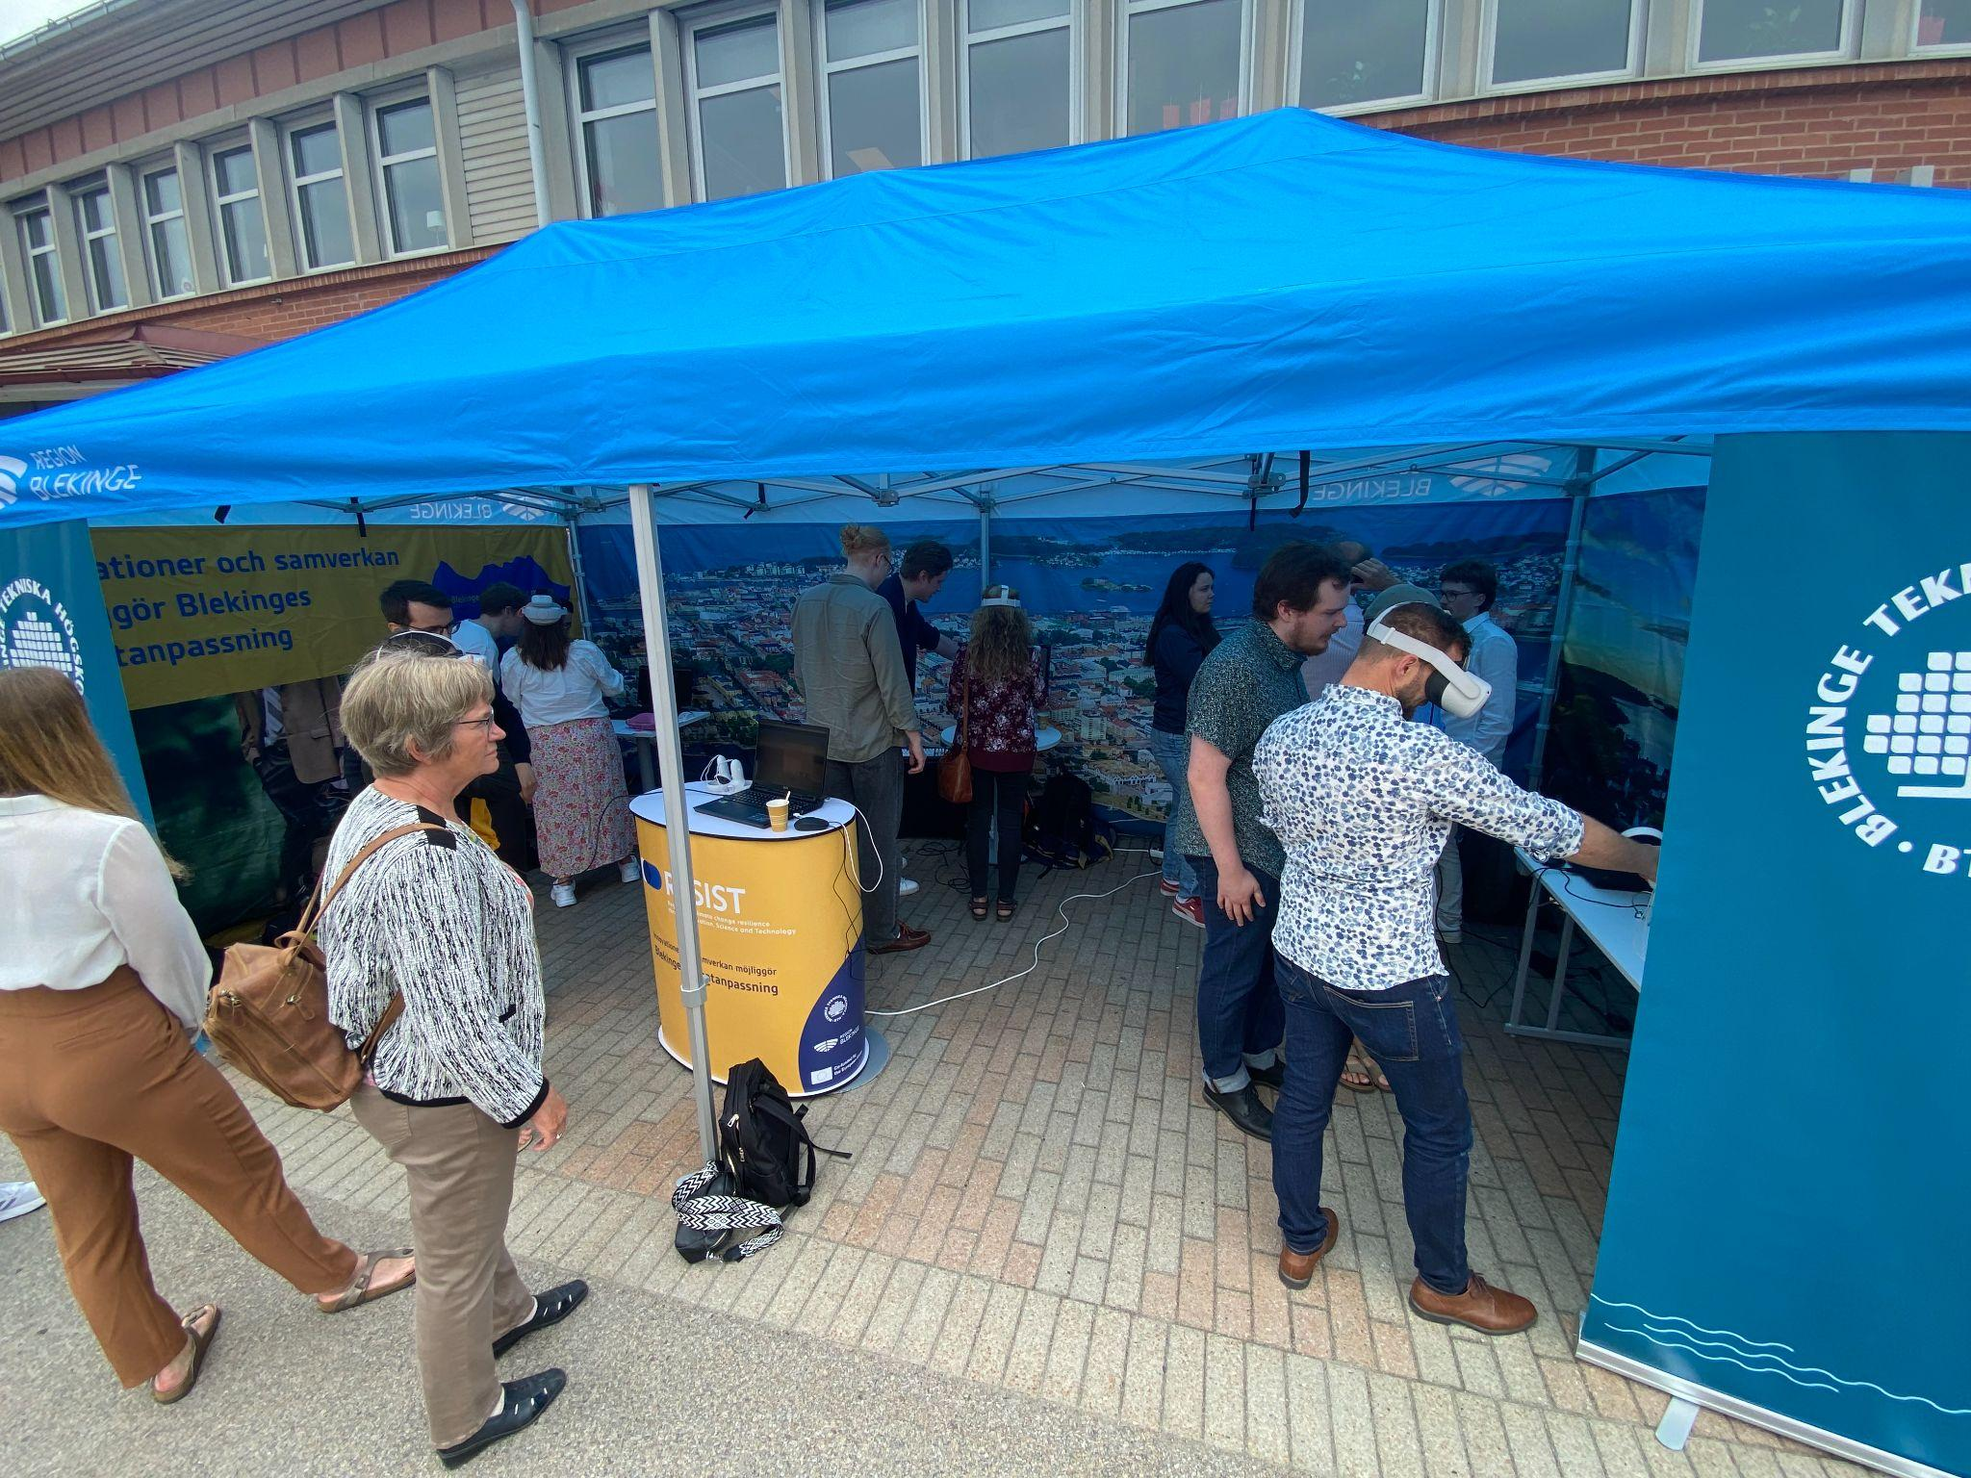
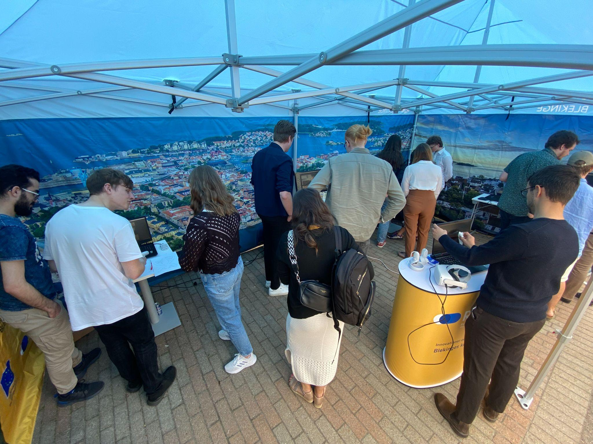
Notes:
Climate Tech Tour (CTT) - concept

Slide 9
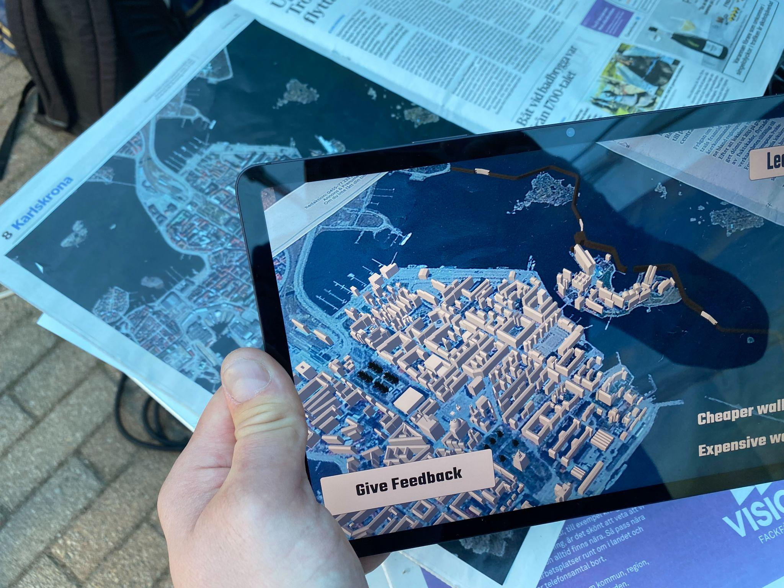
STUDENT PROJECT
Notes:
CTT demo 1 - anadigi outer border

Slide 10
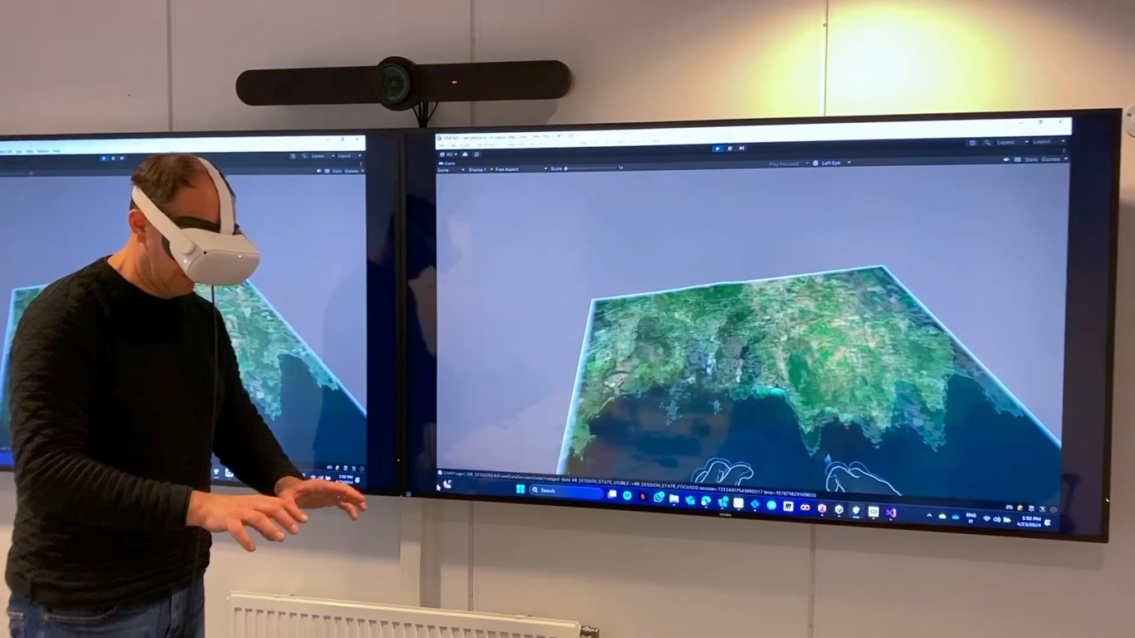
RESEARCH
RESEARCH
STUDENT PROJECT
Notes:
CTT demo 1 - anadigi outer border

Slide 11
Dimensions of transformative innovation
CCA awareness: High levels of awareness, understanding and communication
Directionality: Defining goals and scope of strategic actions to reflect societal challenges with endorsement at highest political level
Articulating instrument portfolios & defining synergies between funding sources: establishing all-encompassing instrument portfolios addressing whole innovation cycle and various aspects of CCA, paired with adequate funding.
Ensuring cross-domain synergies: favouring whole-of-government approaches to ensure greater horizontal coherence between various thematic policy areas resulting in coordinated mixes of instruments.
Increasing breadth & depth of stakeholder involvement: working towards social acceptance of new solutions and shaping of innovative developments, as well as improving public trust, opening up public debates, managing diverse and sometimes conflicting views over alternative pathways.
Setting up effective multi-level governance models: maximising potential of vertical synergies, recognising complementary roles for various governance levels - local, regional, national and EU;
Making room for experimentation: providing adequate space for risk-taking and creativity - ensuring a risk-tolerant environment to facilitate new solutions.
Securing high levels of policy intelligence and strategic capacity: building strong evidence-based policy learning capacities, based on a solid knowledge base and skills to manage transitions.

Slide 12
Selected dimensions
Directionality:
Defining goals and scope of strategic actions to reflect societal challenges with endorsement at highest political level
Setting up effective multi-level governance models: maximising potential of vertical synergies, recognising complementary roles for various governance levels - local, regional, national and EU;
Making room for experimentation:
providing adequate space for risk-taking and creativity - ensuring a risk-tolerant environment to facilitate new solutions.
(for each of them the following slides will cover “State-of-play”, “Bottlenecks” and “Ways forward”)

Slide 13


1) Directionality
State-of-play:
Smart specialisation strategy in Blekinge states that Blekinge should apply, where possible, it´s specialisation areas (tech, marine tech) on EU missions; healthy oceans/water and climate adaptation and societal transformation.
Blekinge was among the first regions to sign the mission charter for CCA.
In the regional development strategy, we define innovation as new products and services implemented in organisations and markets. We emphasise on improving the ability to innovate across all sectors of the society.
Bottlenecks
Less awareness of economic disruptions due to CC and how to explore future possibilities (resilient supply chains, new markets, less costs etc) in working with innovative solutions for CCA.
Planned ways forward
Visualize CCA through the newly established Virtual production studio lab https://www.productdevelopment.se/virtual-production-studio-lab/
Highlight impacts on industry due to CC
How do we further develop the innovation aspect of CCA?
How can innovative approaches to CCA support competitiveness and how do we support stakeholders to understand why and how to innovate for CCA?

Slide 14
2) Setting up effective multi-level governance models
State-of-play:
Climate change adaptation in Sweden involves collaboration at multiple levels of government, as well as coordination among various agencies and organisations.
The institutional landscape of CCA comprises the central level, represented in 32 agencies with sectoral responsibilities, the regional administrative boards with responsibilities in the areas concerning their competences, and the municipalities also in relation to and limited to their competences. Adding to that private landowners and housing companies often have the last say.
Bottlenecks
Regional stakeholders struggle when different agencies or regulations overlap or contradict each other.
There is low level of knowledge about what other entities does. Work being done in silos.
Lack of understanding of CCA impacts and how to align cross sectors and levels.
Planned ways forward
Nudging the importance of working on Multi level governance on a regional level
Transforming knowledge from other European regions into a Swedish context
How do we stimulate increased leadership among policy makers to work with a coherent strategy for CCA?
How do we highlight and raise awareness around goal conflicts and how to address them?

Slide 15
3) Making room for experimentation
State-of-play:
Societal challenges ahead that need to be resolved
Regional focus on S3 w/ Missions
Mission oriented approach to innovation is being launched
Experimentation with Missions
Bottlenecks
No awareness of the need for experimentation.
A dominant culture of traditional linear project management.
Funding for core work, rather than development and experimentation (i.e. project funding is used to fund core work)
SMEs: no time for experimentation and testing
Fragmented coordination
Planned ways forward
Planned ways forward (if any planned at the moment):
Testbed checks with public funding
Trainings
Community – company x is doing it, so should we
What are the tools for attracting stakeholders to use experiments as a tool and way of working?

Slide 16
Ways Forward
Directionality
Visualize CCA through the newly established Virtual production studio lab https://www.productdevelopment.se/virtual-production-studio-lab/
Highlight impacts on industry due to CC
Setting up effective multi-level governance models:
Nudging the importance of working on Multi level governance on a regional level
Transforming knowledge from other European regions into a Swedish context
Making room for experimentation
Planned ways forward (if any planned at the moment):
Testbed checks with public funding
Trainings
Community – company x is doing it, so should we

Slide 17
Selected questions/topics for discussion with peers
Directionality
How do we further develop the innovation aspect of CCA?
How can innovative approaches to CCA support competitiveness and how do we support stakeholders to understand why and how to innovate for CCA?
Setting up effective multi-level governance models:
How do we stimulate increased leadership among policy makers to work with a coherent strategy for CCA?
How do we highlight and raise awareness around goal conflicts and how to address them?
Making room for experimentation
What are the tools for attracting stakeholders to use experiments as a tool and way of working?

